Slide 1
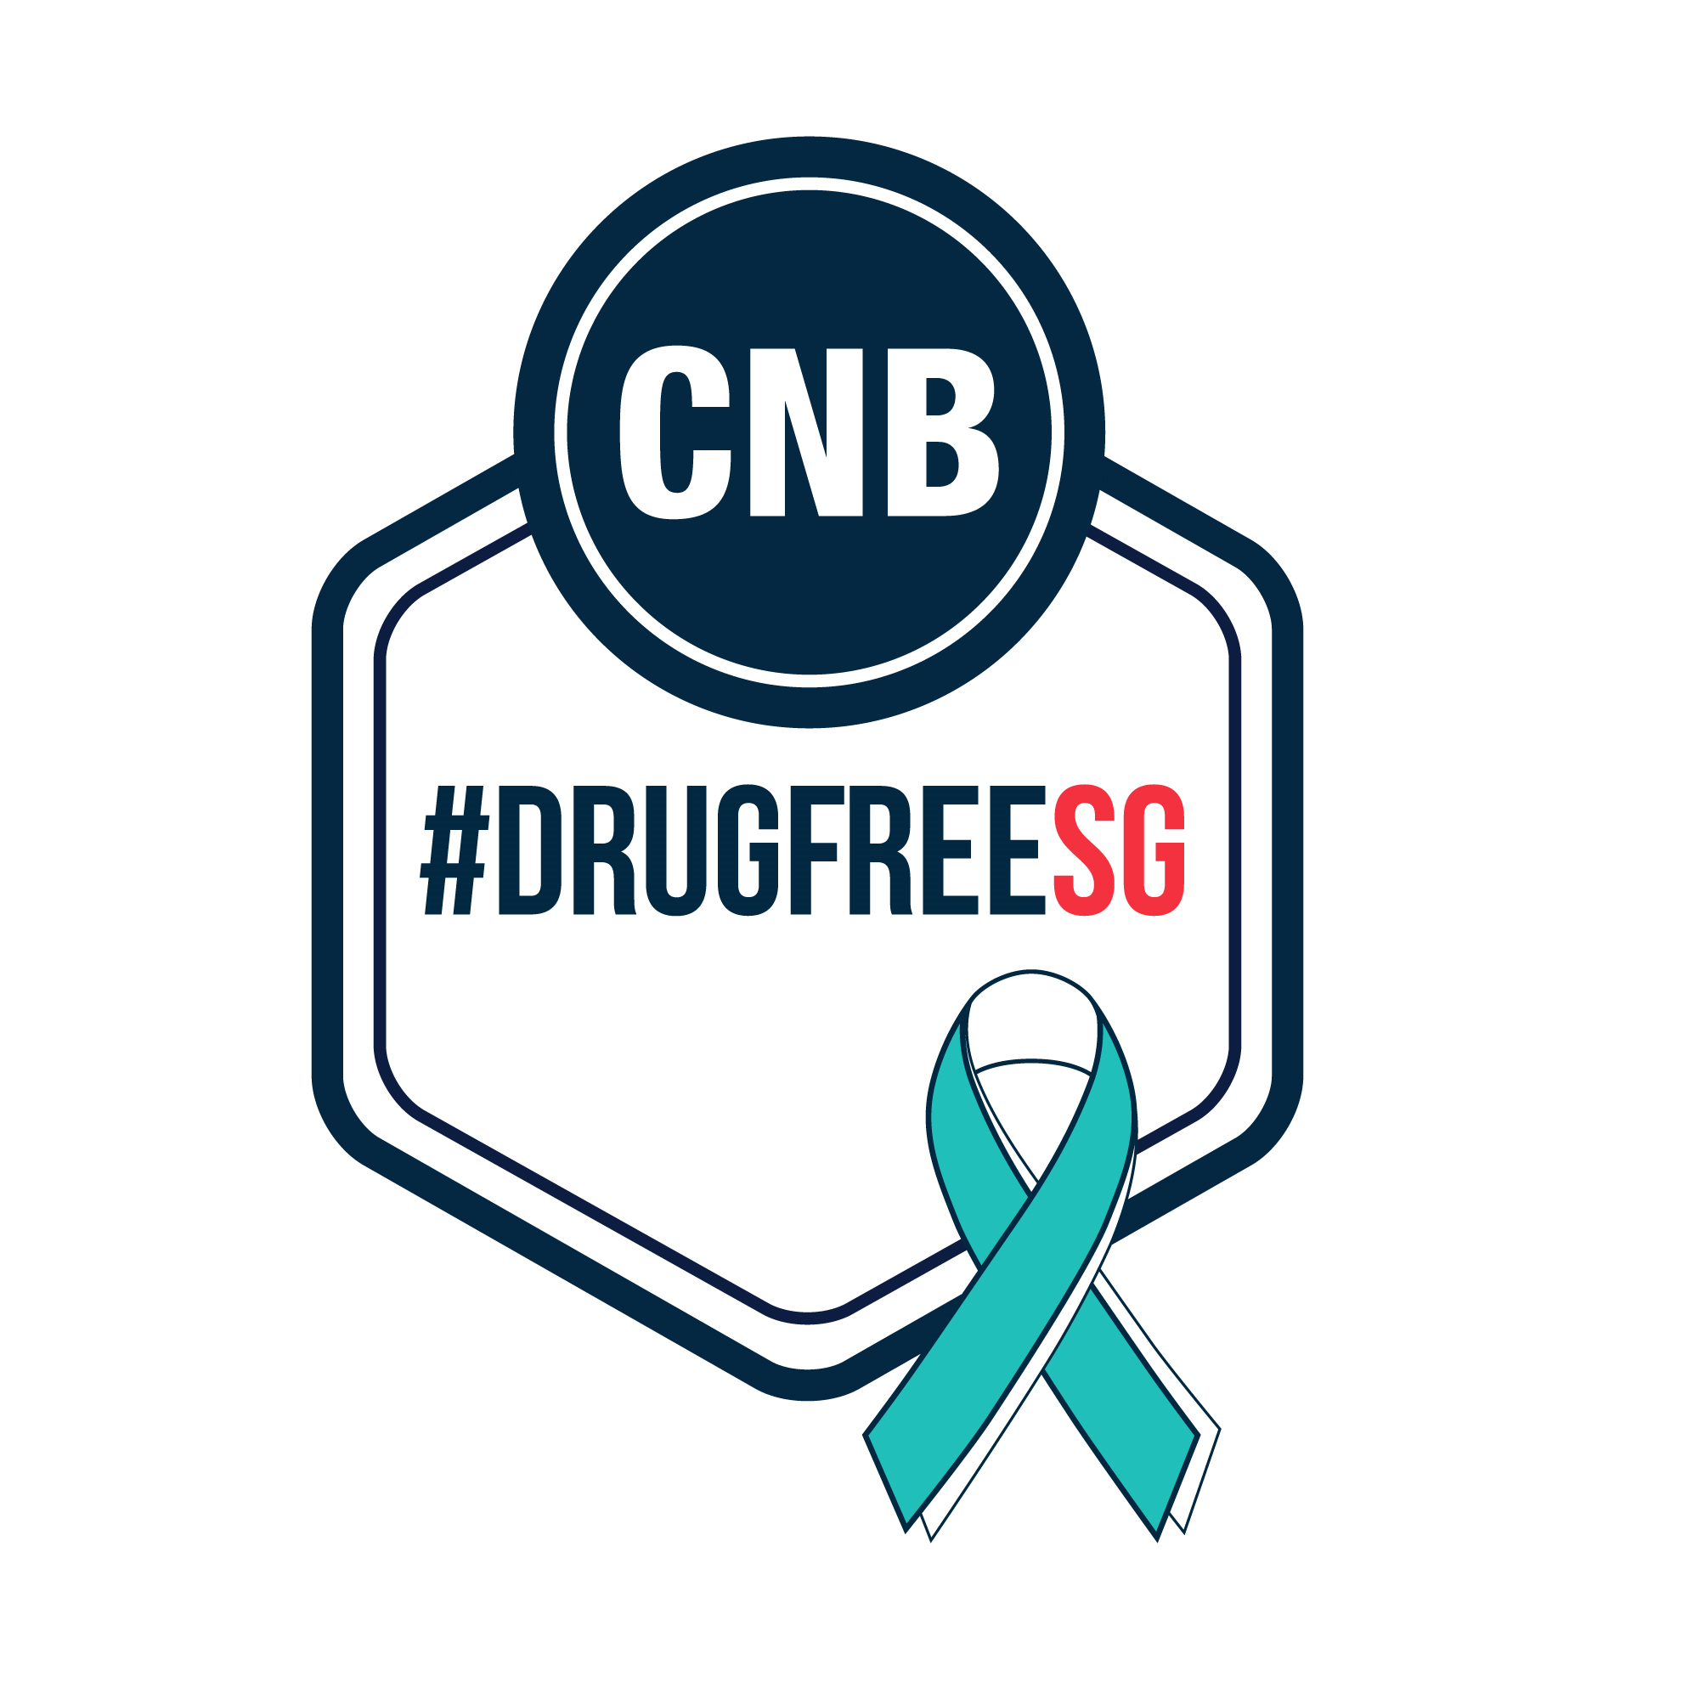
Preventive Drug Education
What you need to know about Singapore’s drug policy and laws,
and how you can help others stay away from drugs

Slide 2
SINGAPORE’S DRUG POLICY
Why Singapore is Tough on Drugs
Singapore aims to create a drug-free society where our people can work, live and play safely
Strict laws serve as an effective deterrent – our laws are designed to ensure harmful drugs are kept out of the easy reach of most people
Legalisation and normalisation of drug use in Singapore will result in children becoming exposed to drugs and the negative consequences of growing up in a neglected environment
Drug abuse harms the abuser, those around him and has large implications on society
Human resource is Singapore’s most precious asset, we cannot allow drugs to take hold of our society
We need your help to spread the anti-drug message in your circles of influence and get our community to stay resilient against drug abuse

Slide 3
LAWS IN PLACE TO HELP US
Common misperception: telling CNB of their suspicion that their family/friends are taking drugs means sending their loved ones to jail
Rehabilitation and aftercare form one of Singapore’s multi-pronged drug control strategies to help drug abusers return to a drug-free life and reintegrate into our society
Our intervention pathways and laws against drug abuse are evidence-based and aimed at helping drug abusers better deal with their drug addiction problem
It is important that abusers seek help so that the right people can engage them in the appropriate intervention programmes early

Slide 4
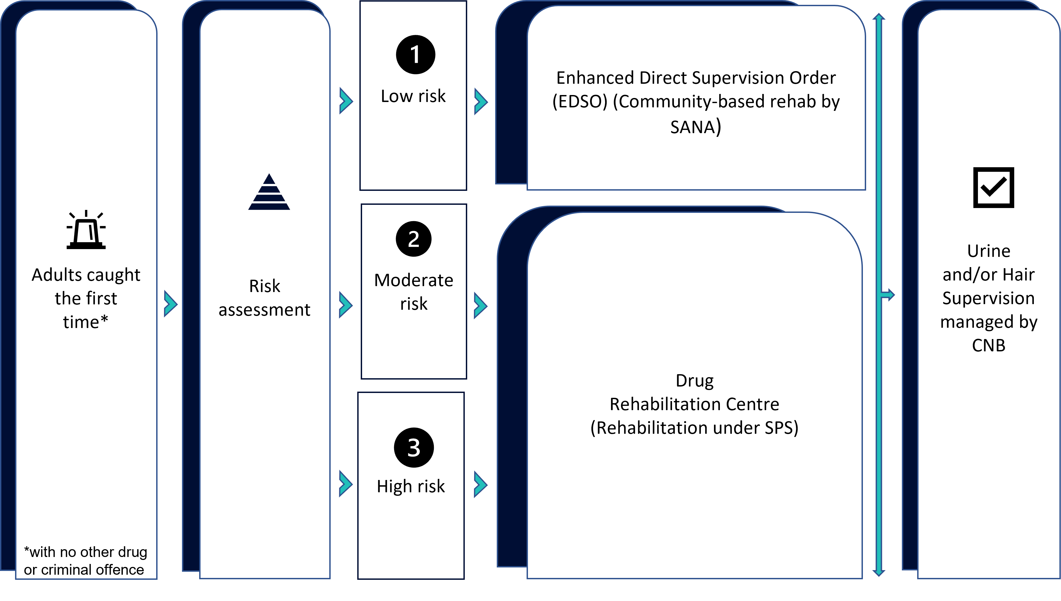
LAWS IN PLACE TO HELP US
Where do drug abusers go when caught?
Drug abusers may be placed on the Drug Supervision Scheme or admitted to the Drug Rehabilitation Centre (DRC) for treatment and rehabilitation
The pathways of recovery depend on the abusers’ assessed risk of reoffending
Rehabilitation and supervision for adults caught for the first time, purely for drug consumption offences

Slide 5
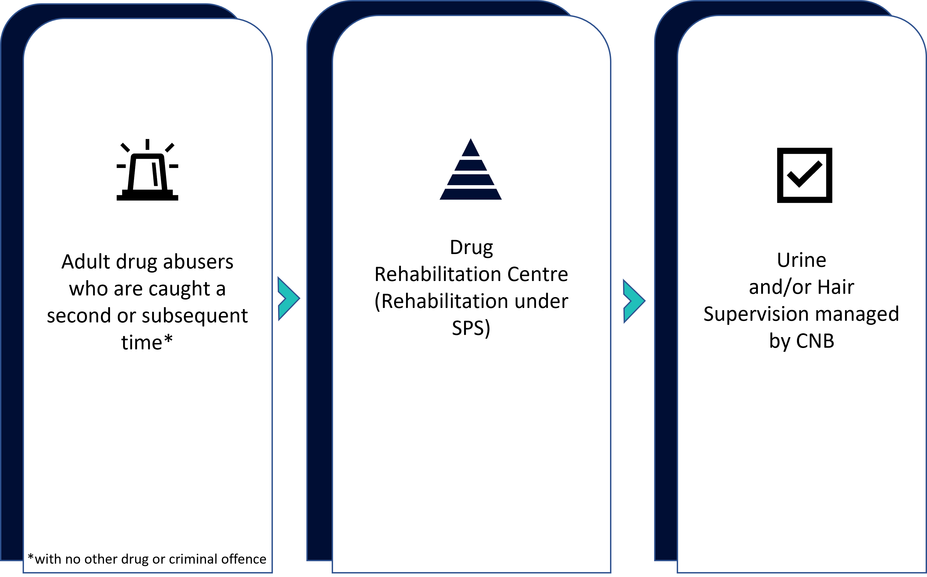
LAWS IN PLACE TO HELP US
Where do drug abusers go when caught?
Rehabilitation and supervision for adults caught multiple times for drug consumption offences

Slide 6
SINGAPORE’S DRUG LAWS
The Misuse of Drugs Act 1973
It is an offence to:
Traffic controlled drugs
Possess and consume controlled drugs
Consume controlled drugs outside of Singapore
Possess drug paraphernalia
Allow and facilitate drug activities
*The above list of offences is not exhaustive

Slide 7
SINGAPORE’S DRUG LAWS
The Misuse of Drugs Act 1973
Sec 5: Trafficking in controlled drugs
Sec 8a: Possession of controlled drugs
Includes selling, giving, administering, sending, transporting, delivering, distributing, or even offering to do any of these acts on behalf of another person
Penalty ranges from imprisonment AND caning, to the mandatory death penalty, depending on the class and quantity of drug trafficked
If found to be in possession, one shall be liable for imprisonment of up to 10 years, or a fine not exceeding S$20,000, or both

Slide 8
SINGAPORE’S DRUG LAWS
The Misuse of Drugs Act 1973
Sec 8b: Consumption of controlled drugs
Sec 8A: Consumption of drugs outside Singapore
It shall be an offence to consume, smoke or administer a controlled or specified drug in Singapore
It shall be an offence for a Singapore Citizen and Permanent Resident, if found as a result of a positive urine test, to consume a controlled drug or specified drug outside of Singapore
If found to be in possession, one shall be liable for imprisonment of up to 10 years, or a fine not exceeding S$20,000, or both
Person may be dealt with as if the offence had been committed in Singapore
Sec 9: Possession of pipes, utensils, etc.
It shall be an offence to be in possession of any pipe, syringe, utensil or apparatus or any articles intended for the smoking, administration or consumption of a controlled drug
Punishment: imprisonment of up to 3 years, or a fine not exceeding S$10,000, or both

Slide 9
SINGAPORE’S DRUG LAWS
The Misuse of Drugs Act 1973
Sec 11: Responsibilities of owners, etc.
Sec 11A, 11B, 11C and 11D: Contaminative behaviours that facilitate or promote drug use
As the owner, tenant, occupier or person-in-charge of any place or premises, you must not allow drug activities (i.e. consumption, trafficking, manufacturing, etc.) to be conducted in the place or premises.
It shall be an offence to:
Arrange or plan gatherings where controlled drugs are to be consumed/trafficked
Expose a child (any person below 16 y/o) to drugs
Introduce a person to a drug trafficker
Teach or provide information on drug-related activities to others
Disseminate information on drug-related activities (e.g. sharing of information on group chat, making a post on FB, etc.)

Slide 10
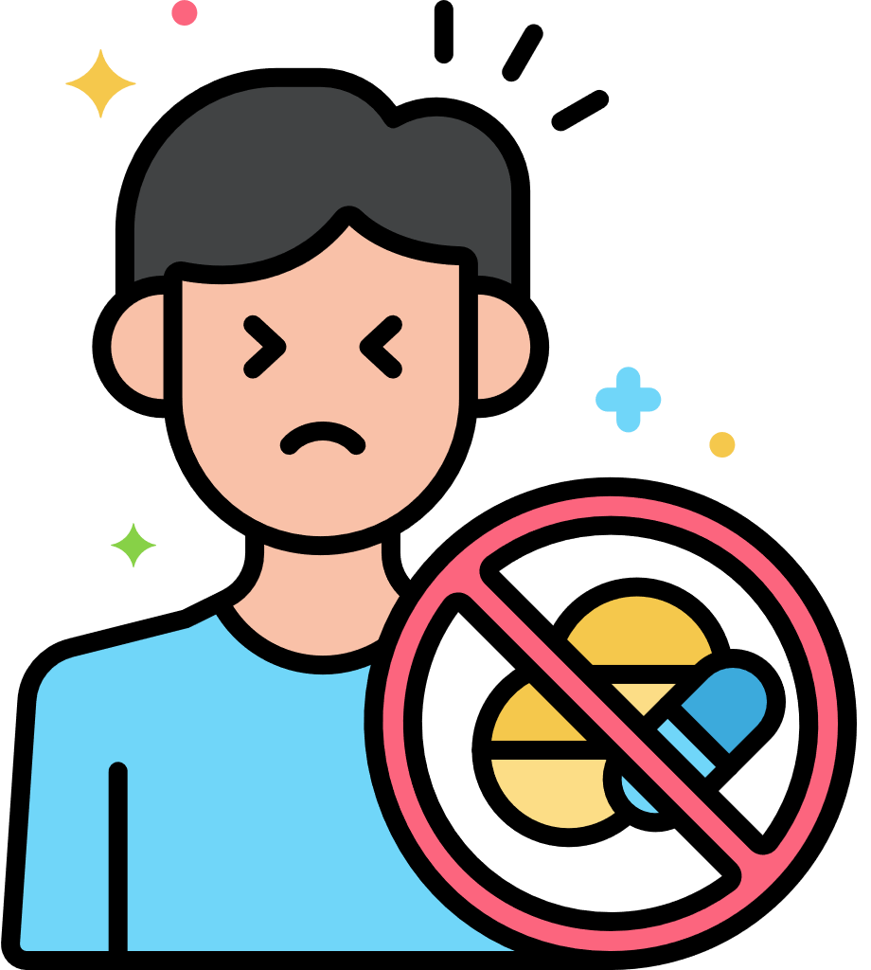
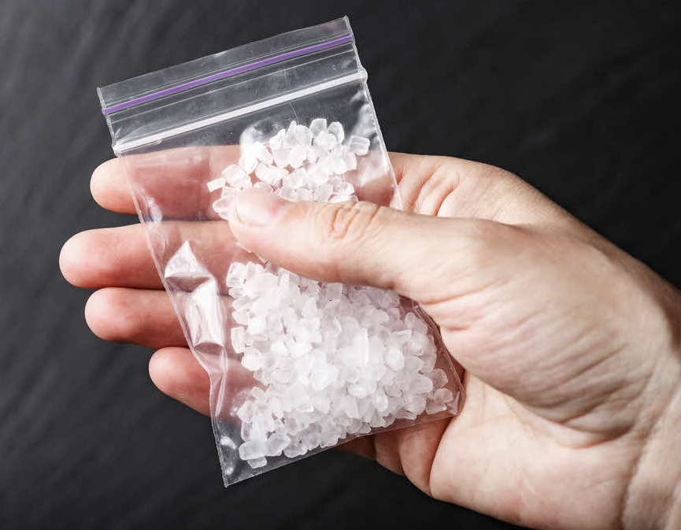
COMMONLY ABUSED DRUGS AND THEIR EFFECTS
Methamphetamine
Effects and Dangers
Increased heart rate and body temperature
Withdrawal Symptoms
Extreme tiredness and hunger
Resembles glass fragments
Highlight addictive and is a strong stimulant
Has a very strong effect on the central nervous system
Fits, stroke and death
Damage to heart and nerves
Liver and kidney diseases
Abnormal behaviour with mood swings, confusion, delusion and hallucination
Anxiety and irritability
Anxiety, depression and irritability
Insomnia
Usually comes in the form of a colourless and odourless crystal
a.k.a. Ice, Glass, Speed, Ya Ba, Shabu

Slide 11
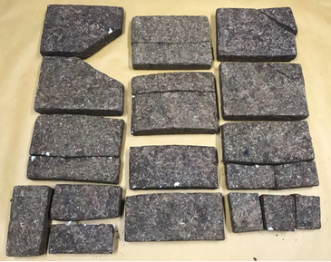
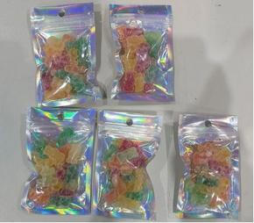
COMMONLY ABUSED DRUGS AND THEIR EFFECTS
Cannabis
Effects and Dangers
Inability to concentrate
Withdrawal Symptoms
Moodiness
Looks like dried herbs or tea leaves
Contains Tetrahydrocannabinol, which affects one’s mood and the way one sees and hears things
Affects concentration and memory, weakening one’s ability to learn
Distorted thinking and perception
Slow reaction, poor balance and co-ordination
Extreme anxiety, depression, confusion and paranoia
Especially harmful to youths
Irritability
Anxiety
Tension
Can come in the form of candies
a.k.a. Marijuana, Pot, Grass, Ganja, Weed

Slide 12
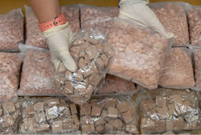
COMMONLY ABUSED DRUGS AND THEIR EFFECTS
Heroin
Effects and Dangers
Lowered heart rate and respiration
Withdrawal Symptoms
Insomnia
Powerful and very addictive
Damage to lungs, kidneys and liver
Dull feeling and tiredness
Difficulty in concentrating
Constipation
Comes in granular, powder or solution form
Can be in whitish or brownish in colour
Watery eyes and runny nose
Irritable and jittery feelings
Tremors and bodily cramps
Chills and sweating
Diarrhoea and vomiting
a.k.a. White, Smack, Junk, Powder, Ubat

Slide 13
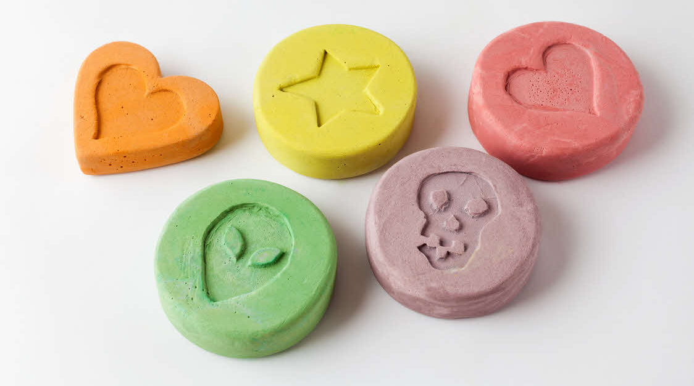
COMMONLY ABUSED DRUGS AND THEIR EFFECTS
Ecstasy
Effects and Dangers
Increased heart rate and blood pressure
Withdrawal Symptoms
Anxiety, depression and uncontrollable fear
Tablets containing MDMA, MDEA and Mda
Come in different colours with different logos stamped on them
May cause exhaustion and dehydration, leading to death
Hallucination
Kidney, liver and brain damage
Long term memory loss
Chills, sweating and vomiting
Inability to think, seek and co-ordinate properly
Jaw clenching, teeth grinding and uncontrollable shaking
Insomnia
a.k.a. ‘E’. Adam, XTC, Pink Lady, Snow White

Slide 14
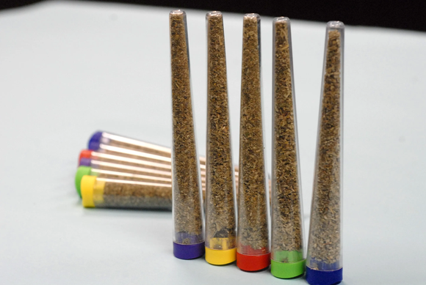
COMMONLY ABUSED DRUGS AND THEIR EFFECTS
New Psychoactive Substances (NPS)
Effects and Dangers
Severe intoxications
Substances that mimic the effects of controlled drugs like cannabis, cocaine, ecstasy, methamphetamine or heroin
Have unknown, dangerous toxicology effects
Equally addictive and harmful as controlled drugs
Severe toxic reaction leading to death
Paranoia (irrational fear or suspicion)
Hallucination
Adverse cardiovascular problems
Renal failure
Seizures
a.k.a. Spice, K2, Bath Salts, Kronic, Bromo-Dragonfly

Slide 15
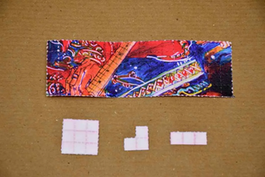
COMMONLY ABUSED DRUGS AND THEIR EFFECTS
Lysergide (LSD)
Effects and Dangers
Numbeness
It is a hallucinogen
Often sold on blotting paper, which is imprinted with a colourful cartoon or design
Loss of control of thoughts
Distorted sight, hearing, smell, touch and taste
Increased heart rate, breathing and body temperature
Severe panic, confusion, hallucination and paranoia (irrational fear or suspicion)
a.k.a. Acid, Trips, Blotters, Tab, Stamp, Seed, Micro, Micro Dot

Slide 16
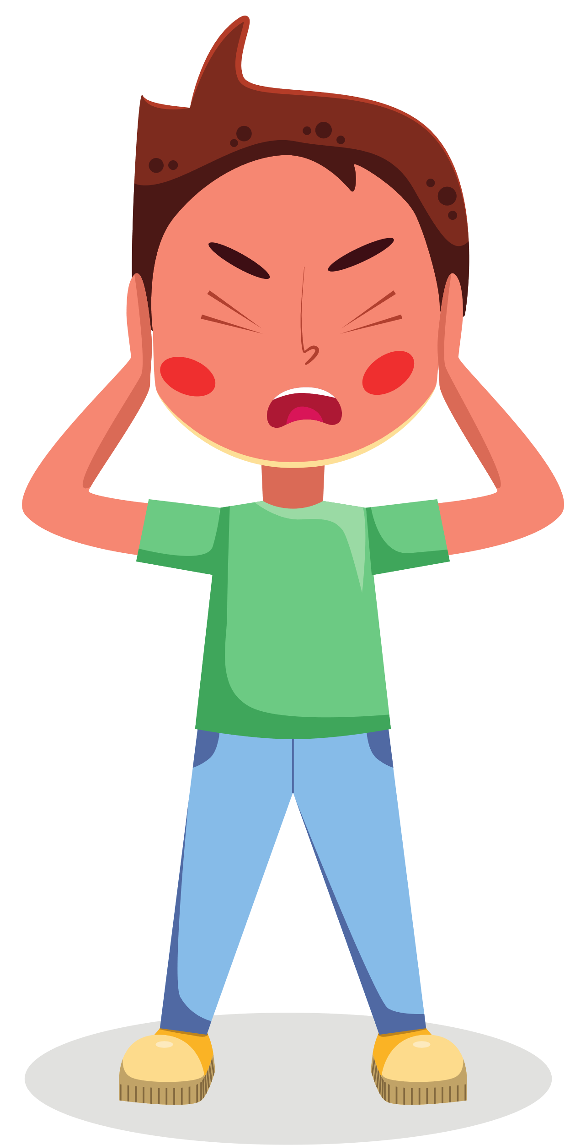
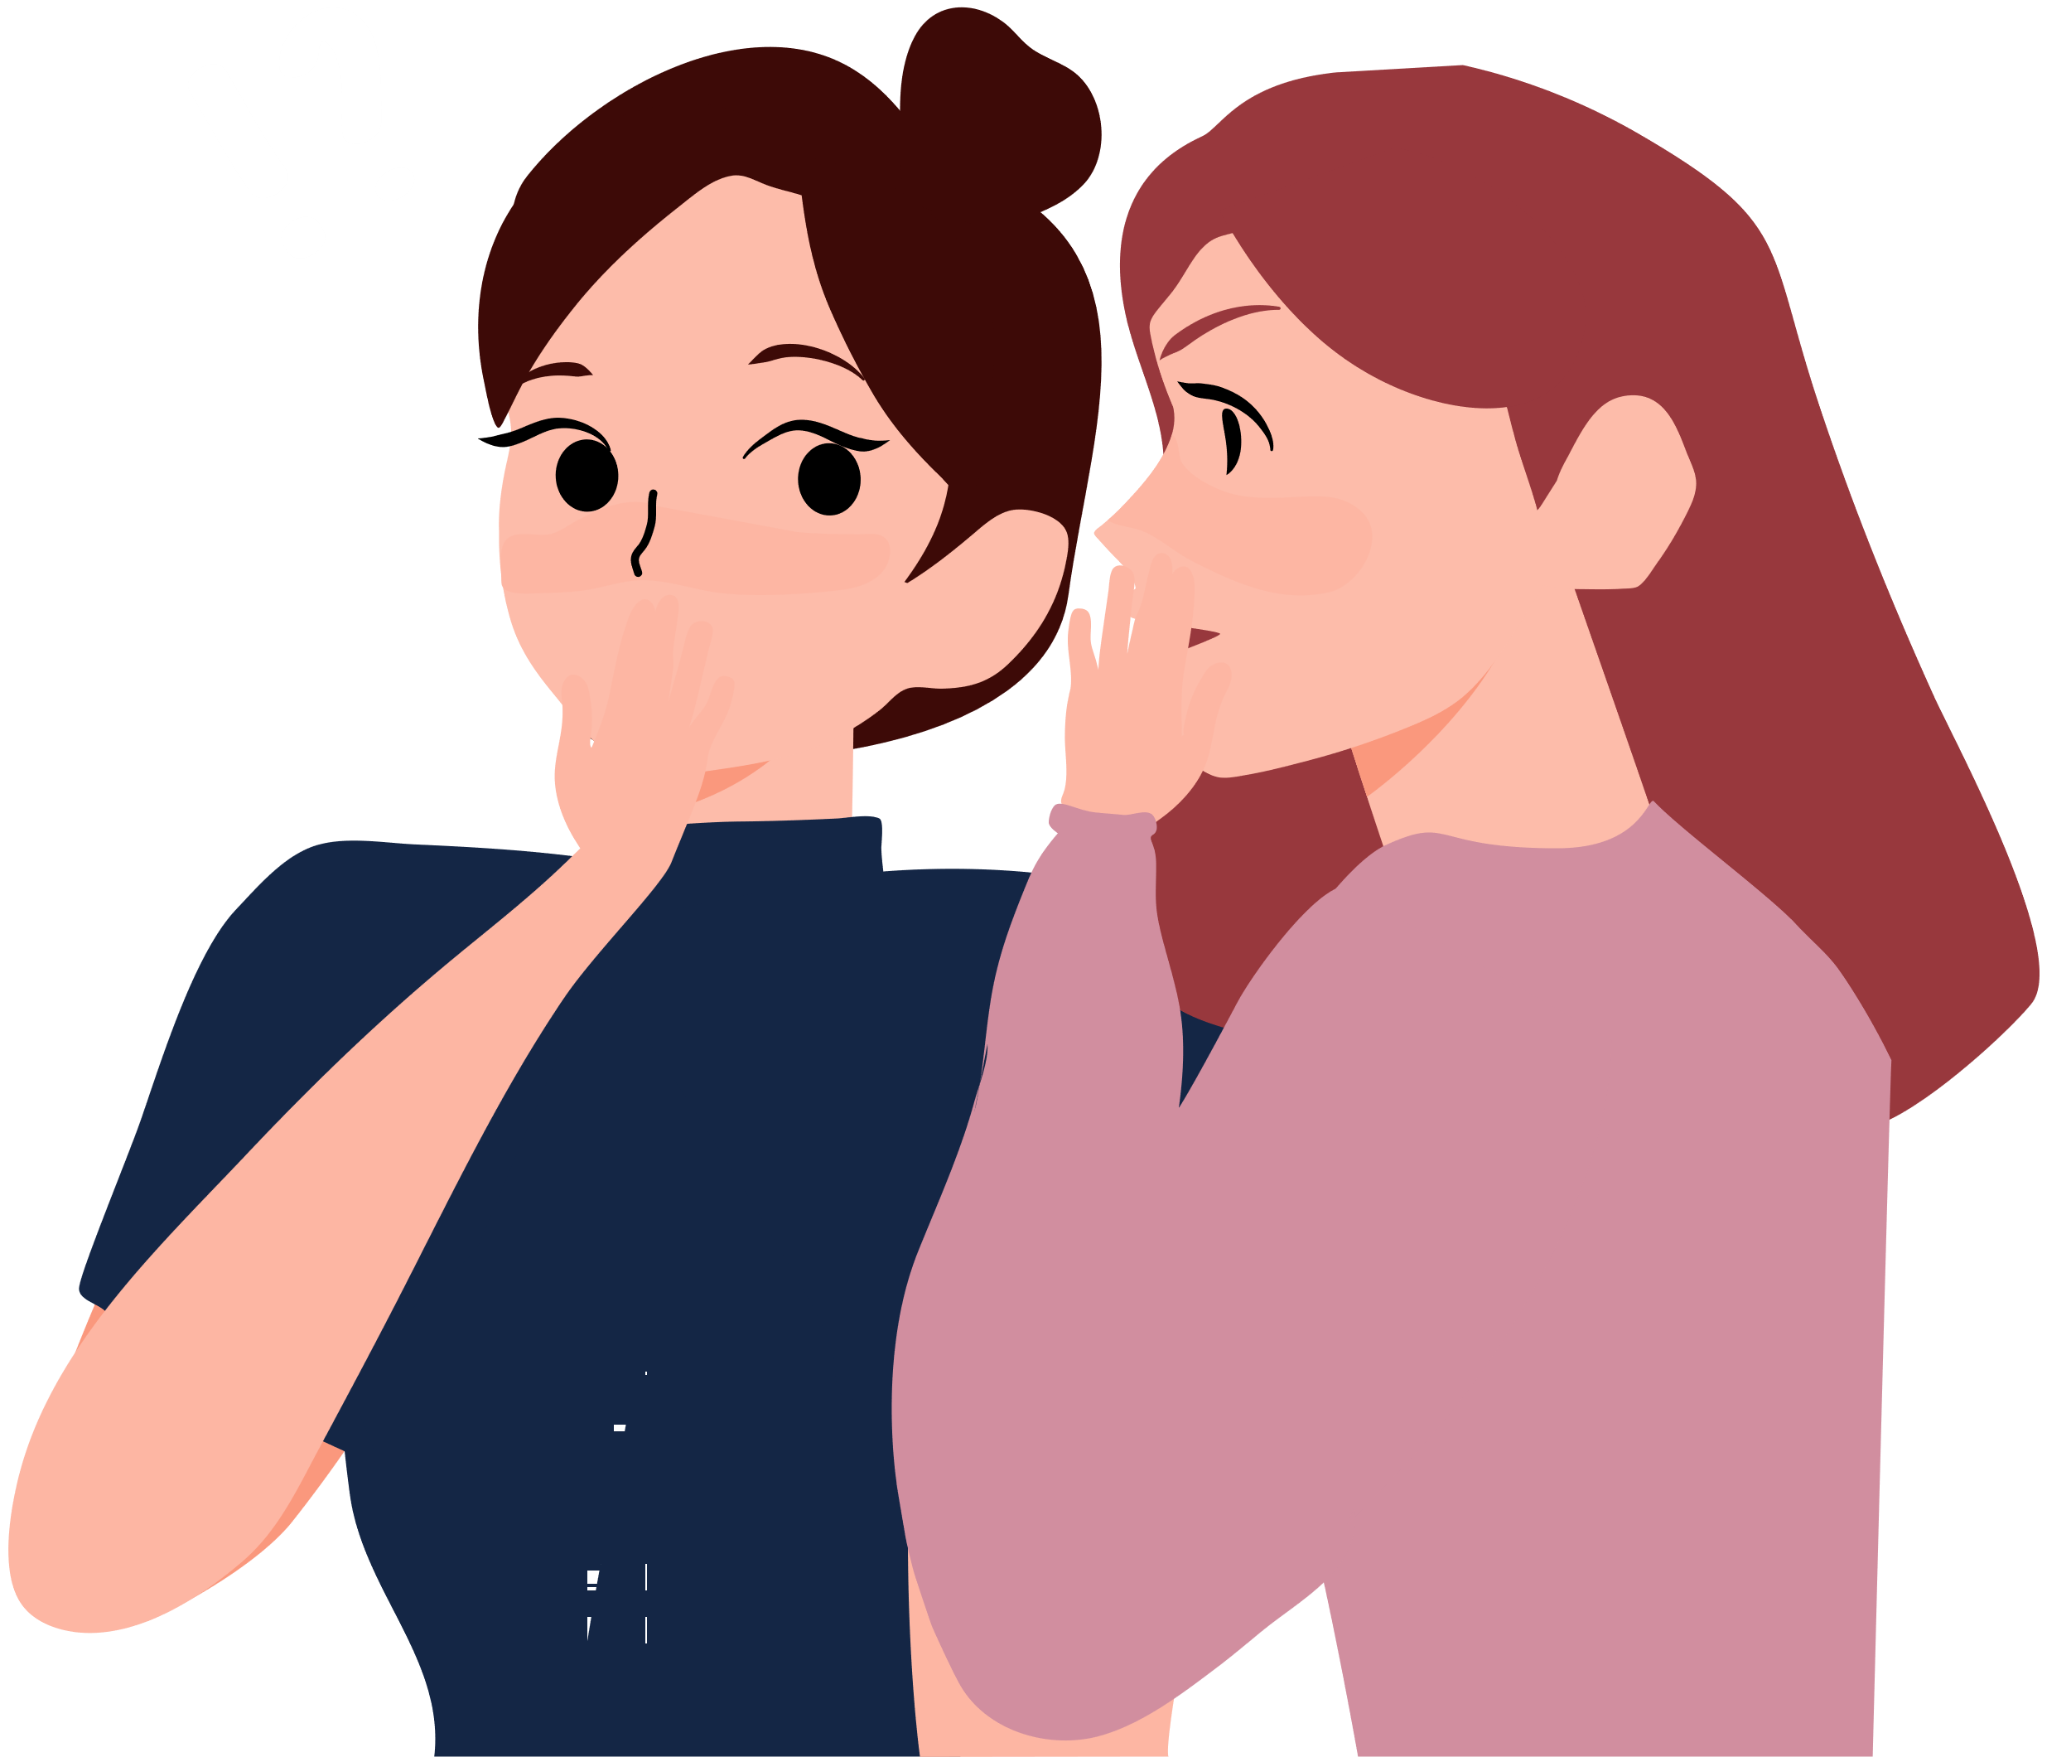
HOW CAN YOU HELP YOUR FRIENDS AND LOVED ONES
Look out for indicators
Pay attention to your friends and loved ones – look out for behavioural and environmental indicators
Communicate
Keep communication open and always listen in a non-judgemental way
Discover his/her talents and encourage him/her to develop them
Find common interests and spend time together
Suggest healthy group activities and sports he/she can join to widen their circle of friends and boost self-esteem
Discuss and remind him/her to stay away from drugs
Teach him/her coping skills and refusal tips
Start your conversations using teachable moments (e.g. news on a well-known person arrested for drug abuse)
Teach him/her to be discerning readers and take a step back to think critically when reading information from dubious online sources that advocate drug use

Slide 17
WHAT SHOULD YOU DO IF…
You suspect someone is involved in drug activities?
You should call CNB at 1800-325-6666
You come across drugs, or what you suspect to be drugs?
You should not touch the items further. Call the Police or CNB at 1800-325-6666.
You see someone abusing drugs at your workplace?
Call the Police or CNB at 1800-325-6666.

Slide 18
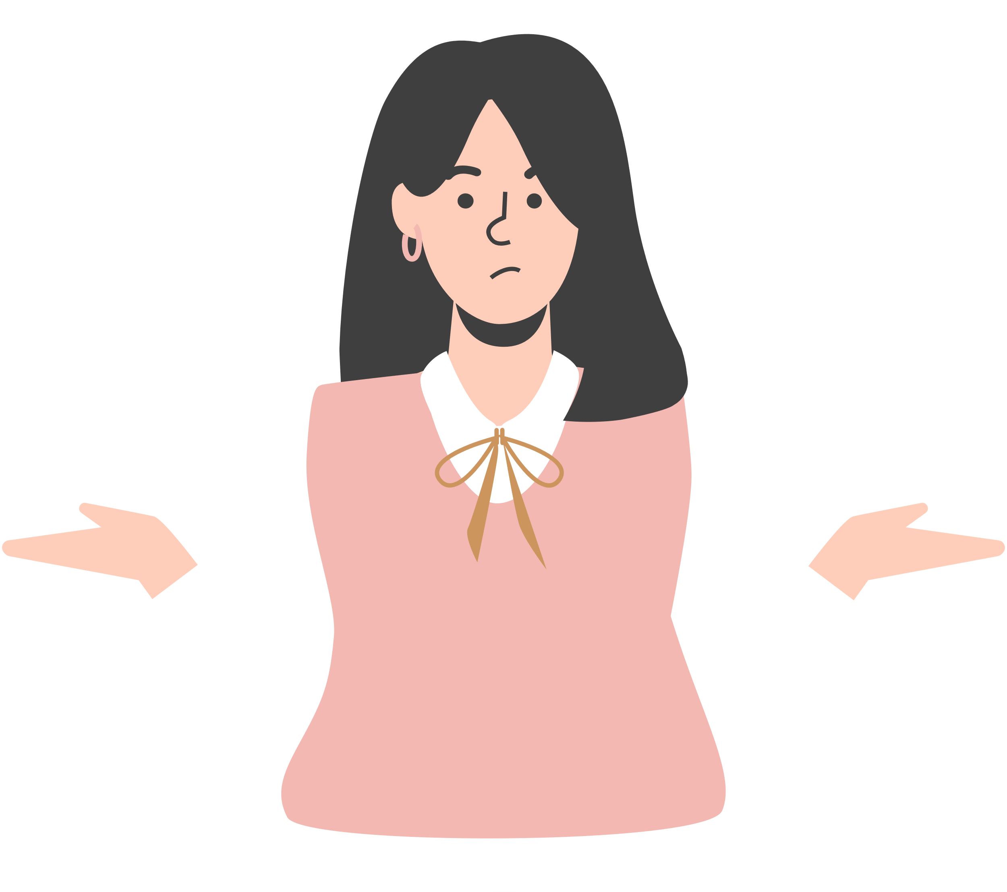
MAKING A REPORT TO CNB
What happens if you report a family/friend?
You will be asked to provide some details so that officers can assess the case
All details will be treated with strict confidentiality
CNB will make an informed assessment and take early intervention and appropriate measures to assist you
Your identity will be treated with strict confidentiality
What happens after your family/friend is arrested?
The person will be brought back to CNB or the police station for investigation
If suspected to be a drug abuser, he/she will be subjected to an Instant
Urine Test (IUT) or hair test and interview by a CNB officer
Convincing someone to stop abusing drugs is not easy, and not everyone takes well to being told about what they should or should not do, especially if it is coming from a peer.
The best way to help your friend is to notify CNB so that they can get professional help soonest to address the drug problem accordingly. Upon notification, CNB will investigate and recommend the appropriate treatment and rehabilitation options based on his/her urine test results and risk profile.
You may feel uncertain about notifying the authorities. But remember, you play an important role in saving your loved ones from falling deeper and deeper into the dangers of drugs.

Slide 19
CONTACTS AND HELPLINES
CONTACT
FOR WHO?
Central Narcotics Bureau
1800-325-6666
Those who wish to report cases of suspected drug abuse
Singapore Anti-Narcotics Association
https://talk2sana.com/tools-for-change/live-chat/
6pm to 9.30pm (Mon to Fri)
Those who wish to talk to para-counsellors about any drug-related issues that you or someone close to you might be facing
To help students know more about the harms and dangers of drugs and how to stay drug-free, CNB works closely with schools and community organisations to offer preventive drug education.
www.cnb.gov.sg
@CNB.DrugFreeSG
Those who wish to know about preventive drug education news, anti-drug articles, activities and events
CNB.DrugFreeSG
Those who wish to watch anti-drug videos
www.eservices.cnb.gov.sg/pde/
Those who wish to request for anti-drug talks, skits and exhibitions at your school or organisation.
CNB_Community_Partnership@cnb.gov.sg
Those who wish to enquire about preventive drug education-related matters or wish to explore collaboration opportunities
www.volunteer.gov.sg
Those who wish to join as an advocate and spread the anti-drug message.
Notes:
www.eservices.cnb.gov.sg/pde/

Slide 20
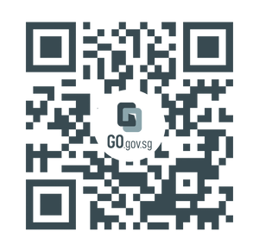
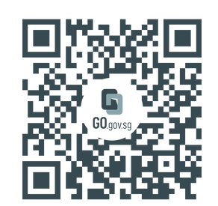
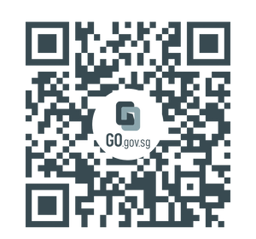
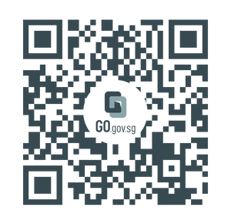
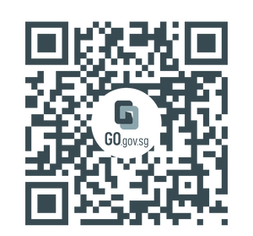
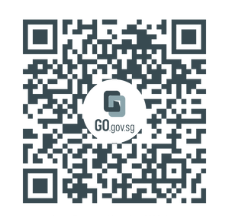
RESOURCES
for information
CNB's website
Drugs and Inhalants
Misuse of Drugs Act 1973
to watch
CNB's YouTube
PDE Video: Down the Rabbit Hole
PDE Video: Last Days

Slide 21
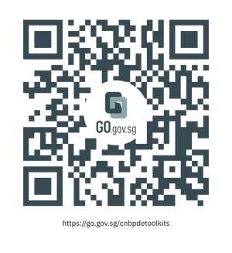
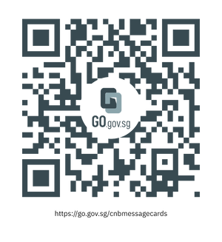
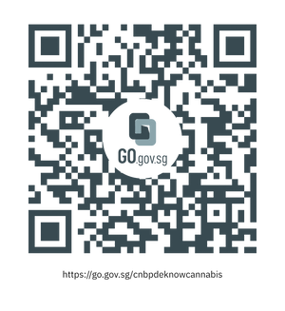
RESOURCES
for parents, educators, counsellors
Smart Parenting articles
PDE toolkits
PDE message cards
Information booklet on Cannabis
Information booklet on New Psychoactive Substances (NPS)

Slide 22
Thank you.
We hope you find this set of resources useful.
Let’s work together towards a drug-free society!

