Slide 1
Answers for Primary 4 Anti-Drug Ambassador Activity Booklet

Slide 2
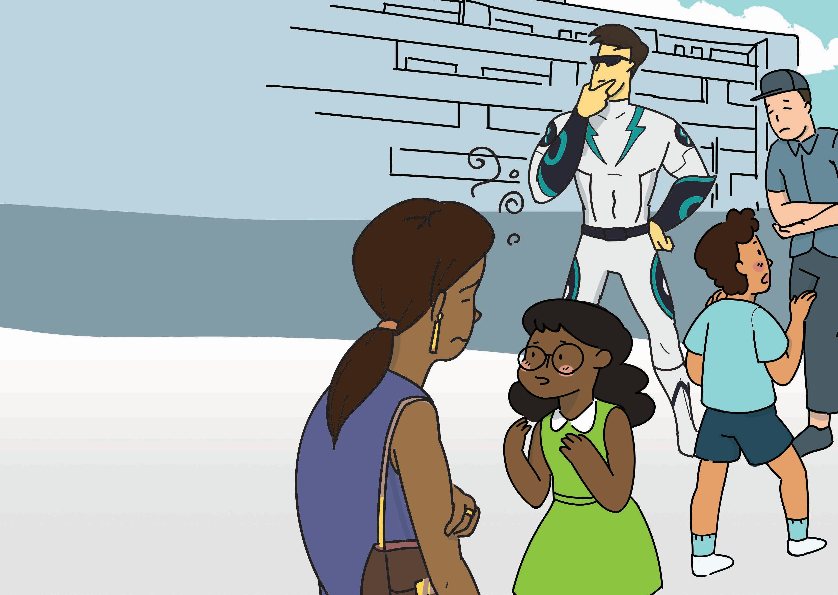

Search for the
warning signs
The drug situation in the neighbourhood is getting worse. Some residents affected by drugs are hindering Hassan and Ashley’s search for Drug Lord’s Lair. To locate the first hidden tool, Captain Drug Buster needs more help to identify the people under the influence of drugs.
Captain Drug Buster has listed some drug-induced effects but Drug Lord has messed it up to confuse everyone! Help Hassan and Ashley search for the tell-tale signs in the puzzle below!
C | O | H | D | K | O | L | J | I | J | O | F | S | F | V | H
O | K | U | A | R | G | U | M | E | N | T | A | T | I | V | E
N | C | L | H | J | K | S | C | V | G | H | T | Z | M | B | I
F | H | A | N | X | I | E | T | Y | K | O | I | E | R | T | Y
U | C | D | T | Y | H | Z | V | N | B | N | G | N | U | F | H
S | I | N | G | H | A | H | K | E | Y | T | U | O | P | E | R
E | M | O | O | N | I | D | F | G | H | i | E | P | O | V | E
D | E | H | S | D | Z | N | G | E | R | I | I | N | G | E | S
O | V | H | A | L | L | U | C | I | N | A | T | I | O | N | G
Find these words
Argumentative
Confused
Hallucination
Fatigue
Anxiety
Key
Find the odd one out! The hidden tool located here is a
Key
5
6

Slide 3
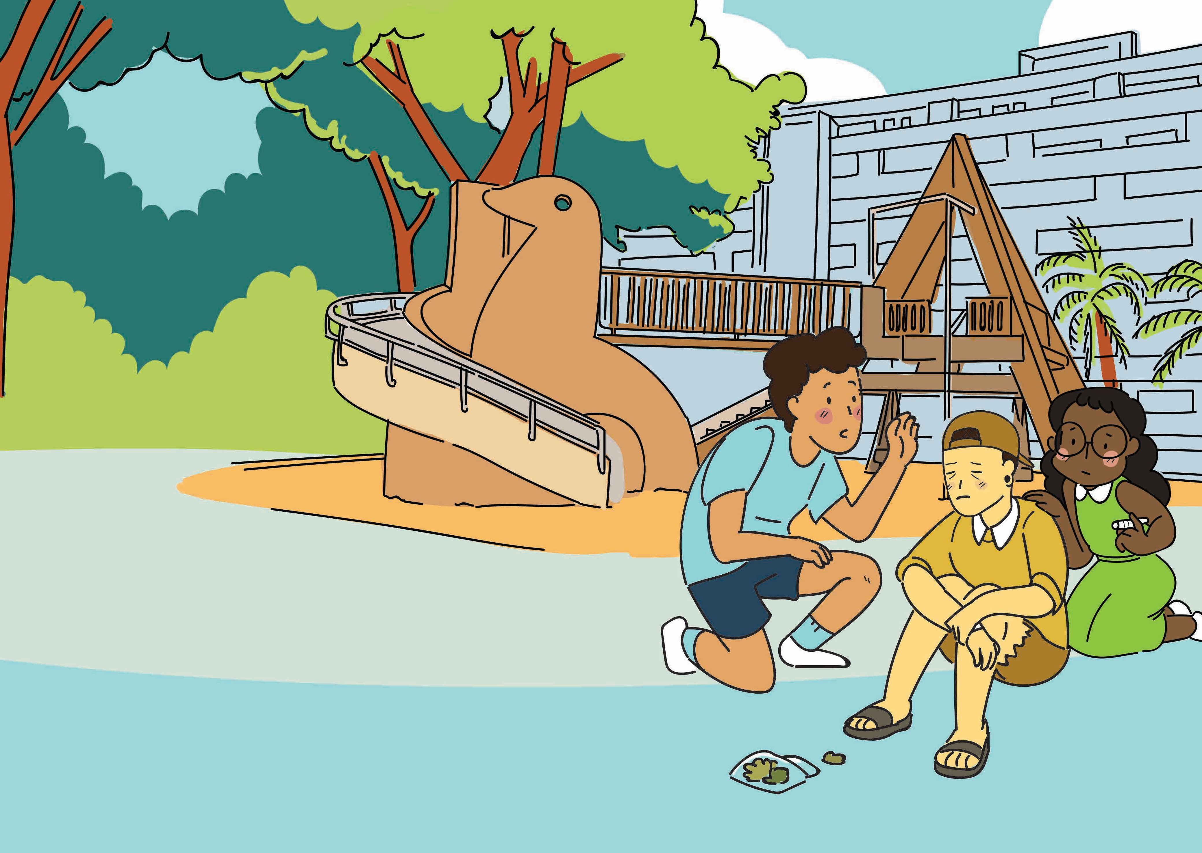
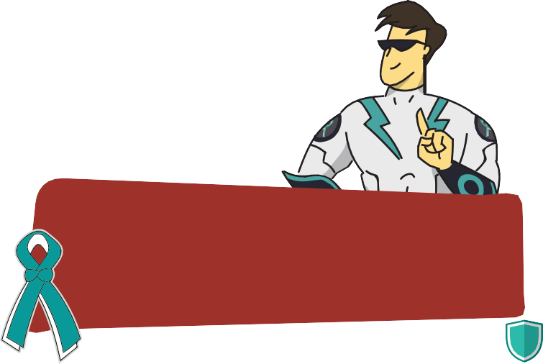
kNOw Drugs
After locating the first hidden tool, Hassan and Ashley bump into their classmate, Alex at the playground. Alex appears confused and dazed after inhaling smoke from a plant-like substance. He cannot recognise Hassan and Ashley.
Together with Captain Drug Buster, Hassan and Ashley, rearrange the jumbled-up words and use the drug fact sheet to find out what drug is affecting Alex.
OPT BANANICS
EDEW SGRAS IJRAAUNAM
Pot
Cannabis
Weed
Grass
Marijuana
“The drug you have identified can cause poor balance and coordination, extreme anxiety and paranoia in abusers.”
7
Pot, Cannabis, Weed, Grass, Marijuana
8

Slide 4
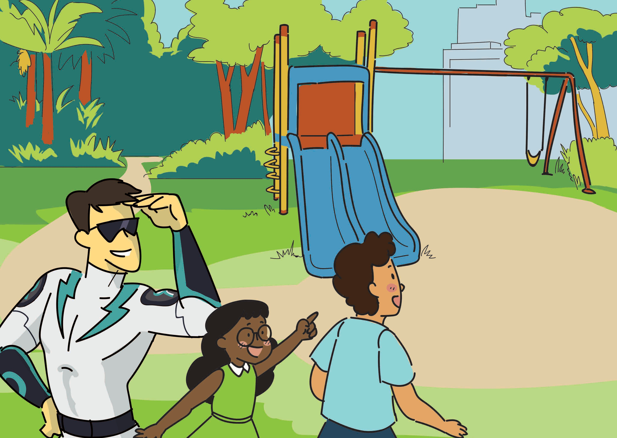

Get out
of harm’s way
1÷1=
7+8=
Captain Drug Buster sees something shiny at the fitness corner. Hassan and Ashley notice that there are some mathematical problems written on the ground. Could this be the clue to the second hidden tool?
Connect the dots to help Hassan and Ashley unravel the mystery item. Hurry, before it’s too late!
1x2=
84÷6=
2+1=
98-85=
2x2=
108÷9=
3+2=
22÷2=
2x3=
5x2=
14÷2=
27÷3=
5+3=
The second hidden tool located is a
Shield
“Heroin is a highly addictive drug that can cause severe health problems such as collapsed veins, lung and heart infections and death.”
9
10

Slide 5
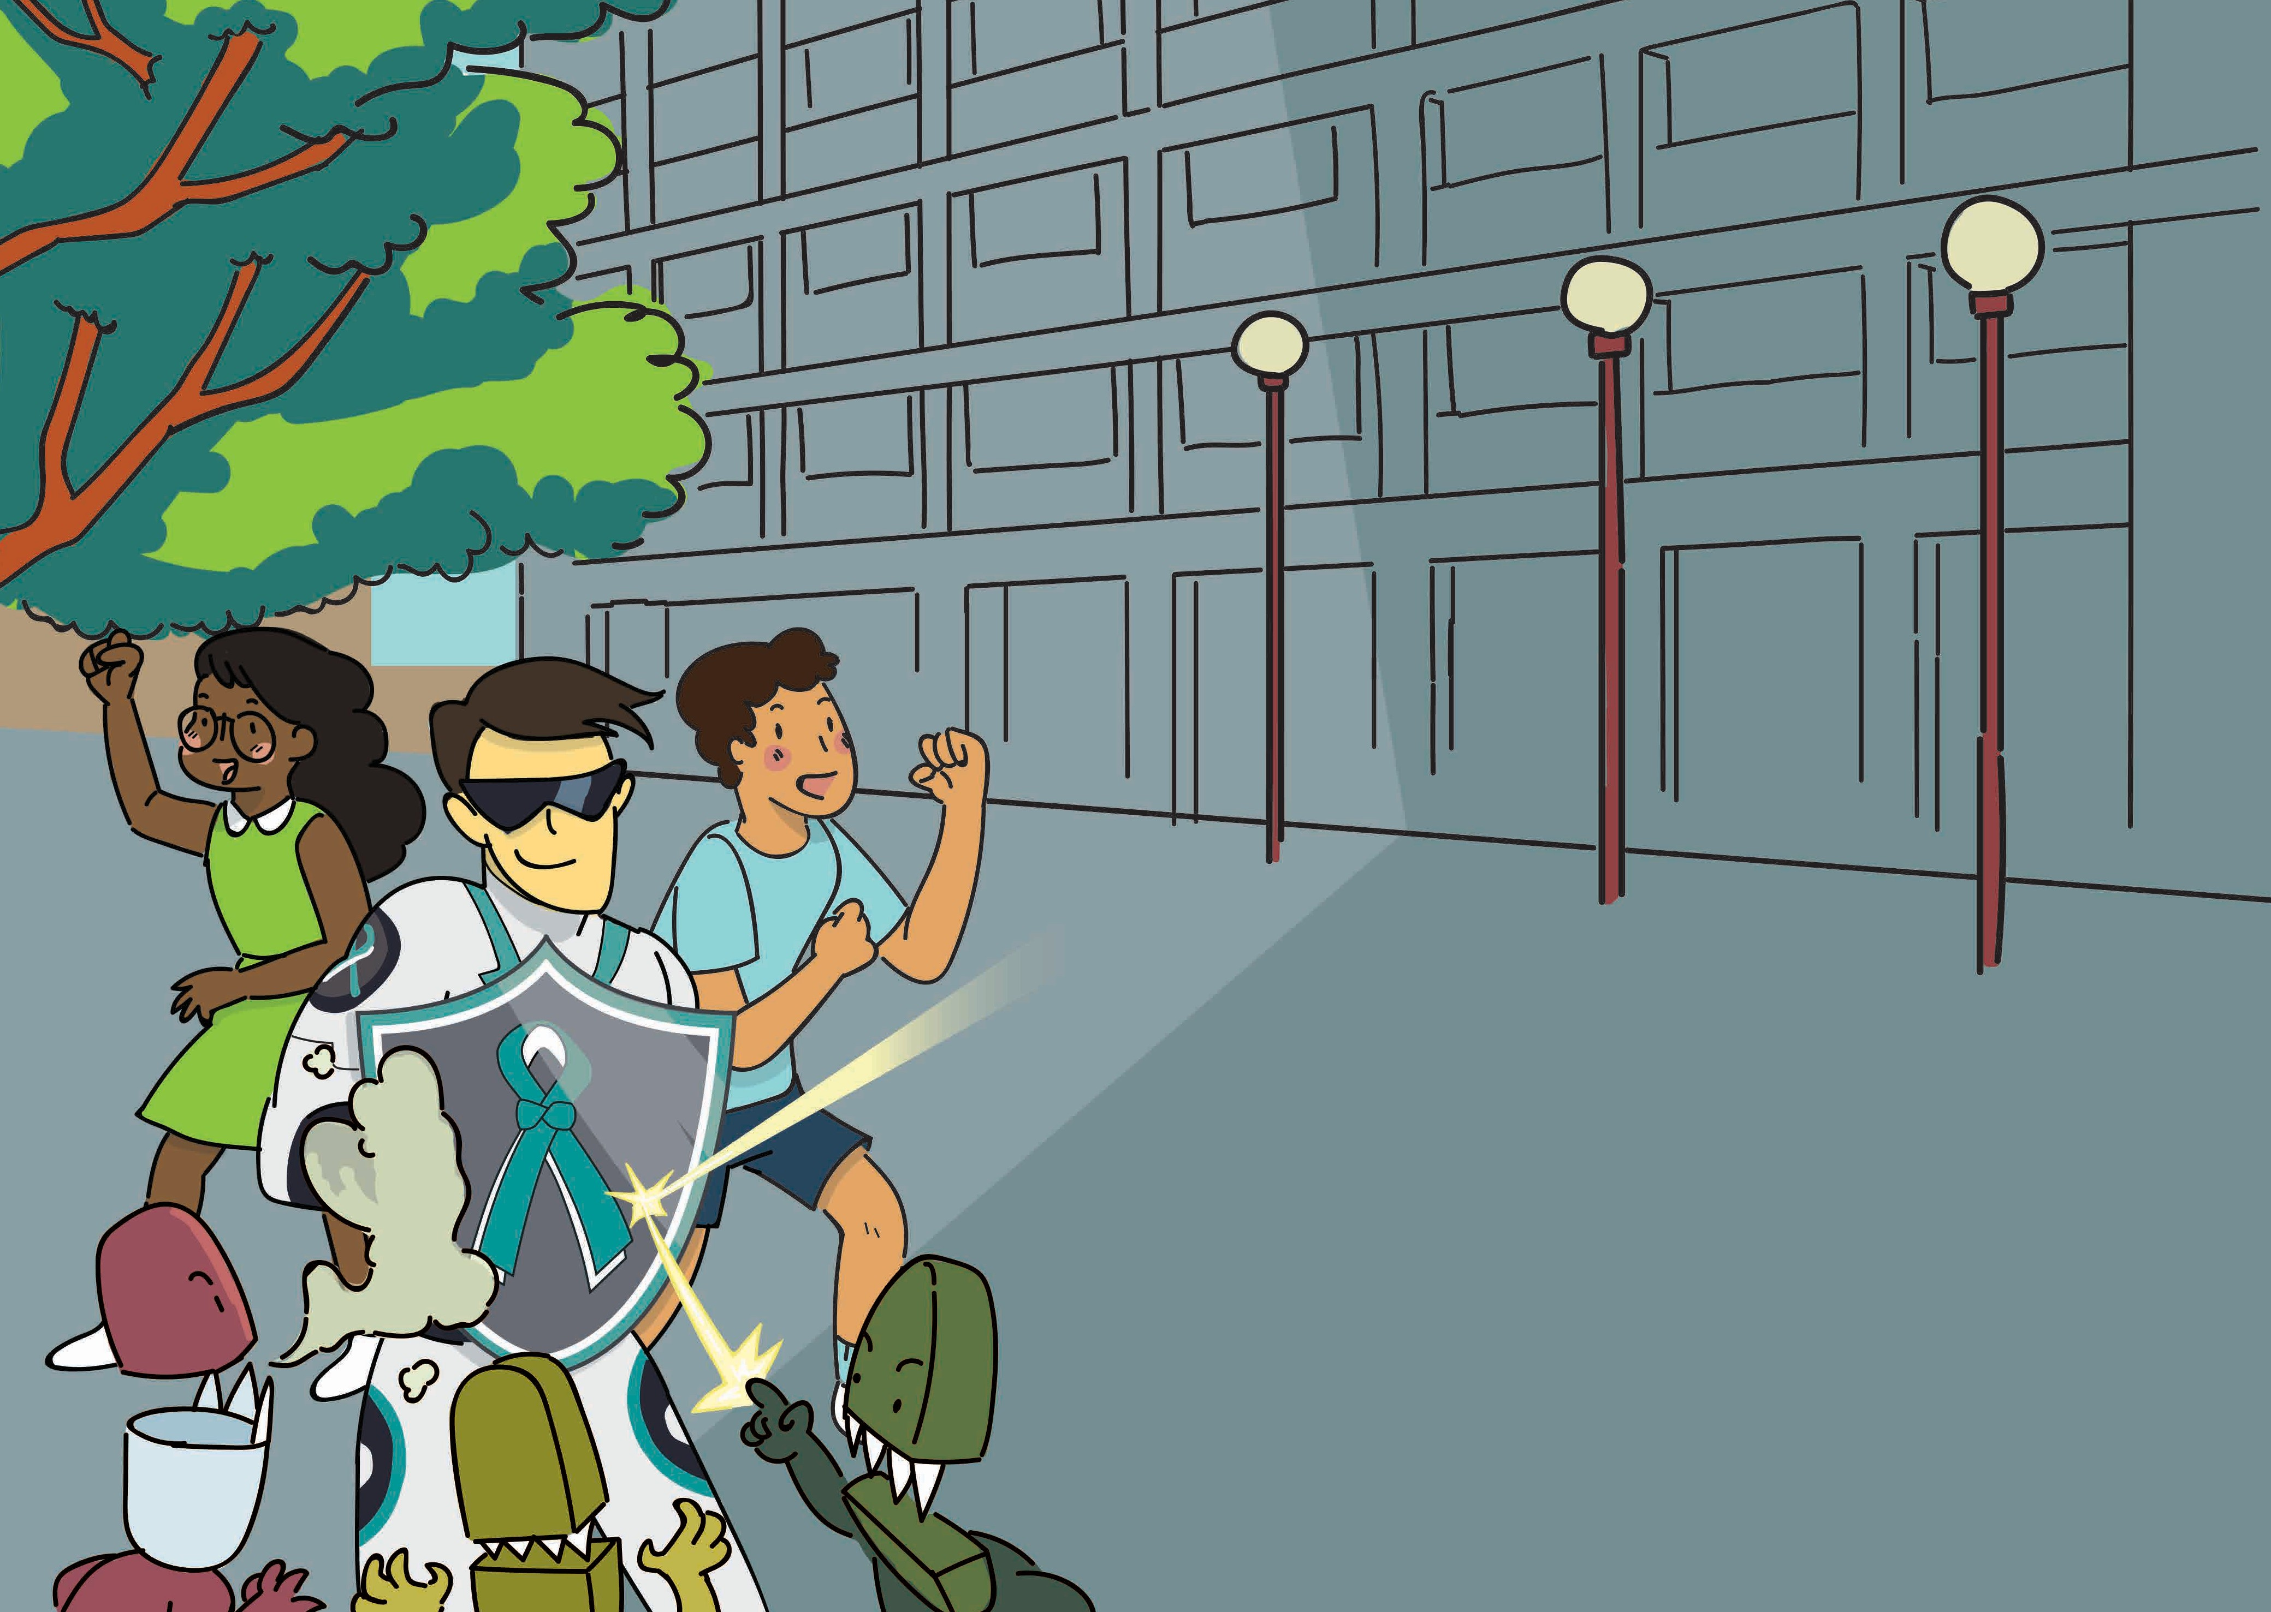
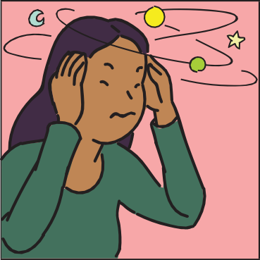
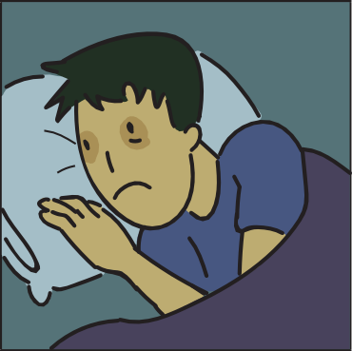
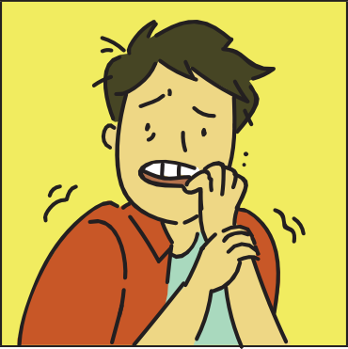
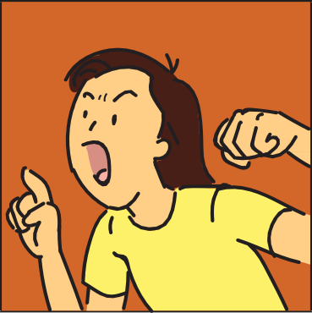
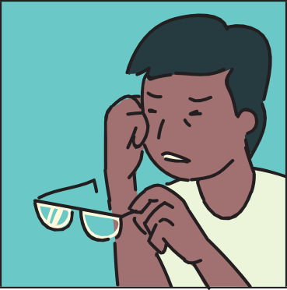
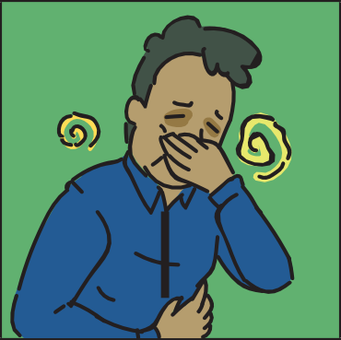
Shield us from
Dizziness
Blurred Vision
Insomnia
Nausea
Anxiety
Aggressive Behaviour
the harms
It seems like the Drug Minions are closing in on Captain Drug Buster, Hassan and Ashley! Hassan and Ashley need something to fend off the Drug Minions and help those under the influence of drugs!
Using the shield, help them ward off the Drug Minions by matching the correct harms of Inhalants to the correct picture.
Dizziness
Insomnia
Anxiety
Aggressive Behaviour
Blurred Vision
Nausea
11
12

Slide 6
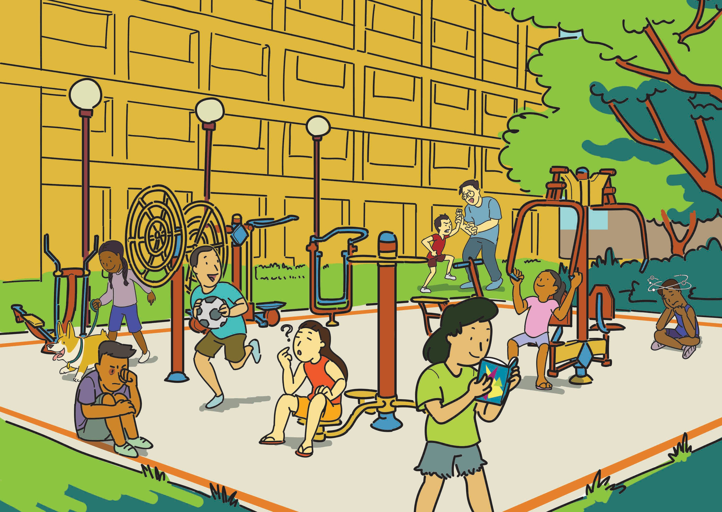

Bust the harms
With the Drug Minions defeated, the fitness corner is finally drug-free! Captain Drug Buster, Hassan and Ashley ask the
residents for directions to Drug Lord’s Lair, but they are unable to answer clearly as they are recovering from the harmful effects
of drugs.
Help Captain Drug Buster, Hassan and Ashley bust the harms by crossing out the tell-tale signs of drug abuse and ensure that
everyone is safe and drug-free before they continue on their quest!
Aggressive behaviour
Working out
Dizziness
Walking the dog
Playing football
Red eyes
Confusion
“Methamphetamine is a highly addictive drug that can lead to fits, stroke and death.”
Reading a book
13
14

Slide 7
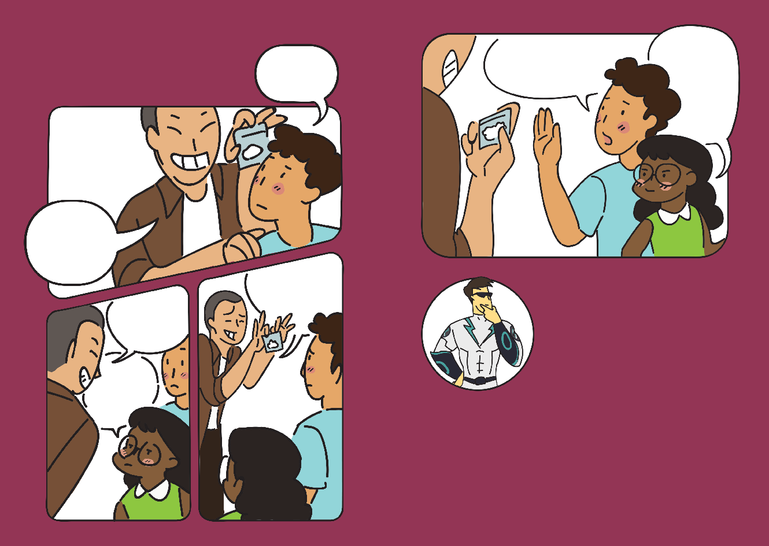
Say NO to drugs!
We have no time for drugs.
We need to help Captain Drug
Buster save more people from
Drug Lord.
I’m pretty sure you are offering us drugs. Drugs can lead to death. No thanks.
Erm...
As Hassan and Ashley are leaving the fitness corner, they are surrounded by some teenagers who
look aggressive.
The teenagers offer some white powdery substances to Hassan and Ashley.
what is it?
Hey, try this.
Come on! Trying it once is not going to kill you.
How will you say NO to a drug offer?
It’s good stuff that will make you forget all your troubles.
This sounds too good to be true. We are
not interested in unknown substances.
15
16

Slide 8
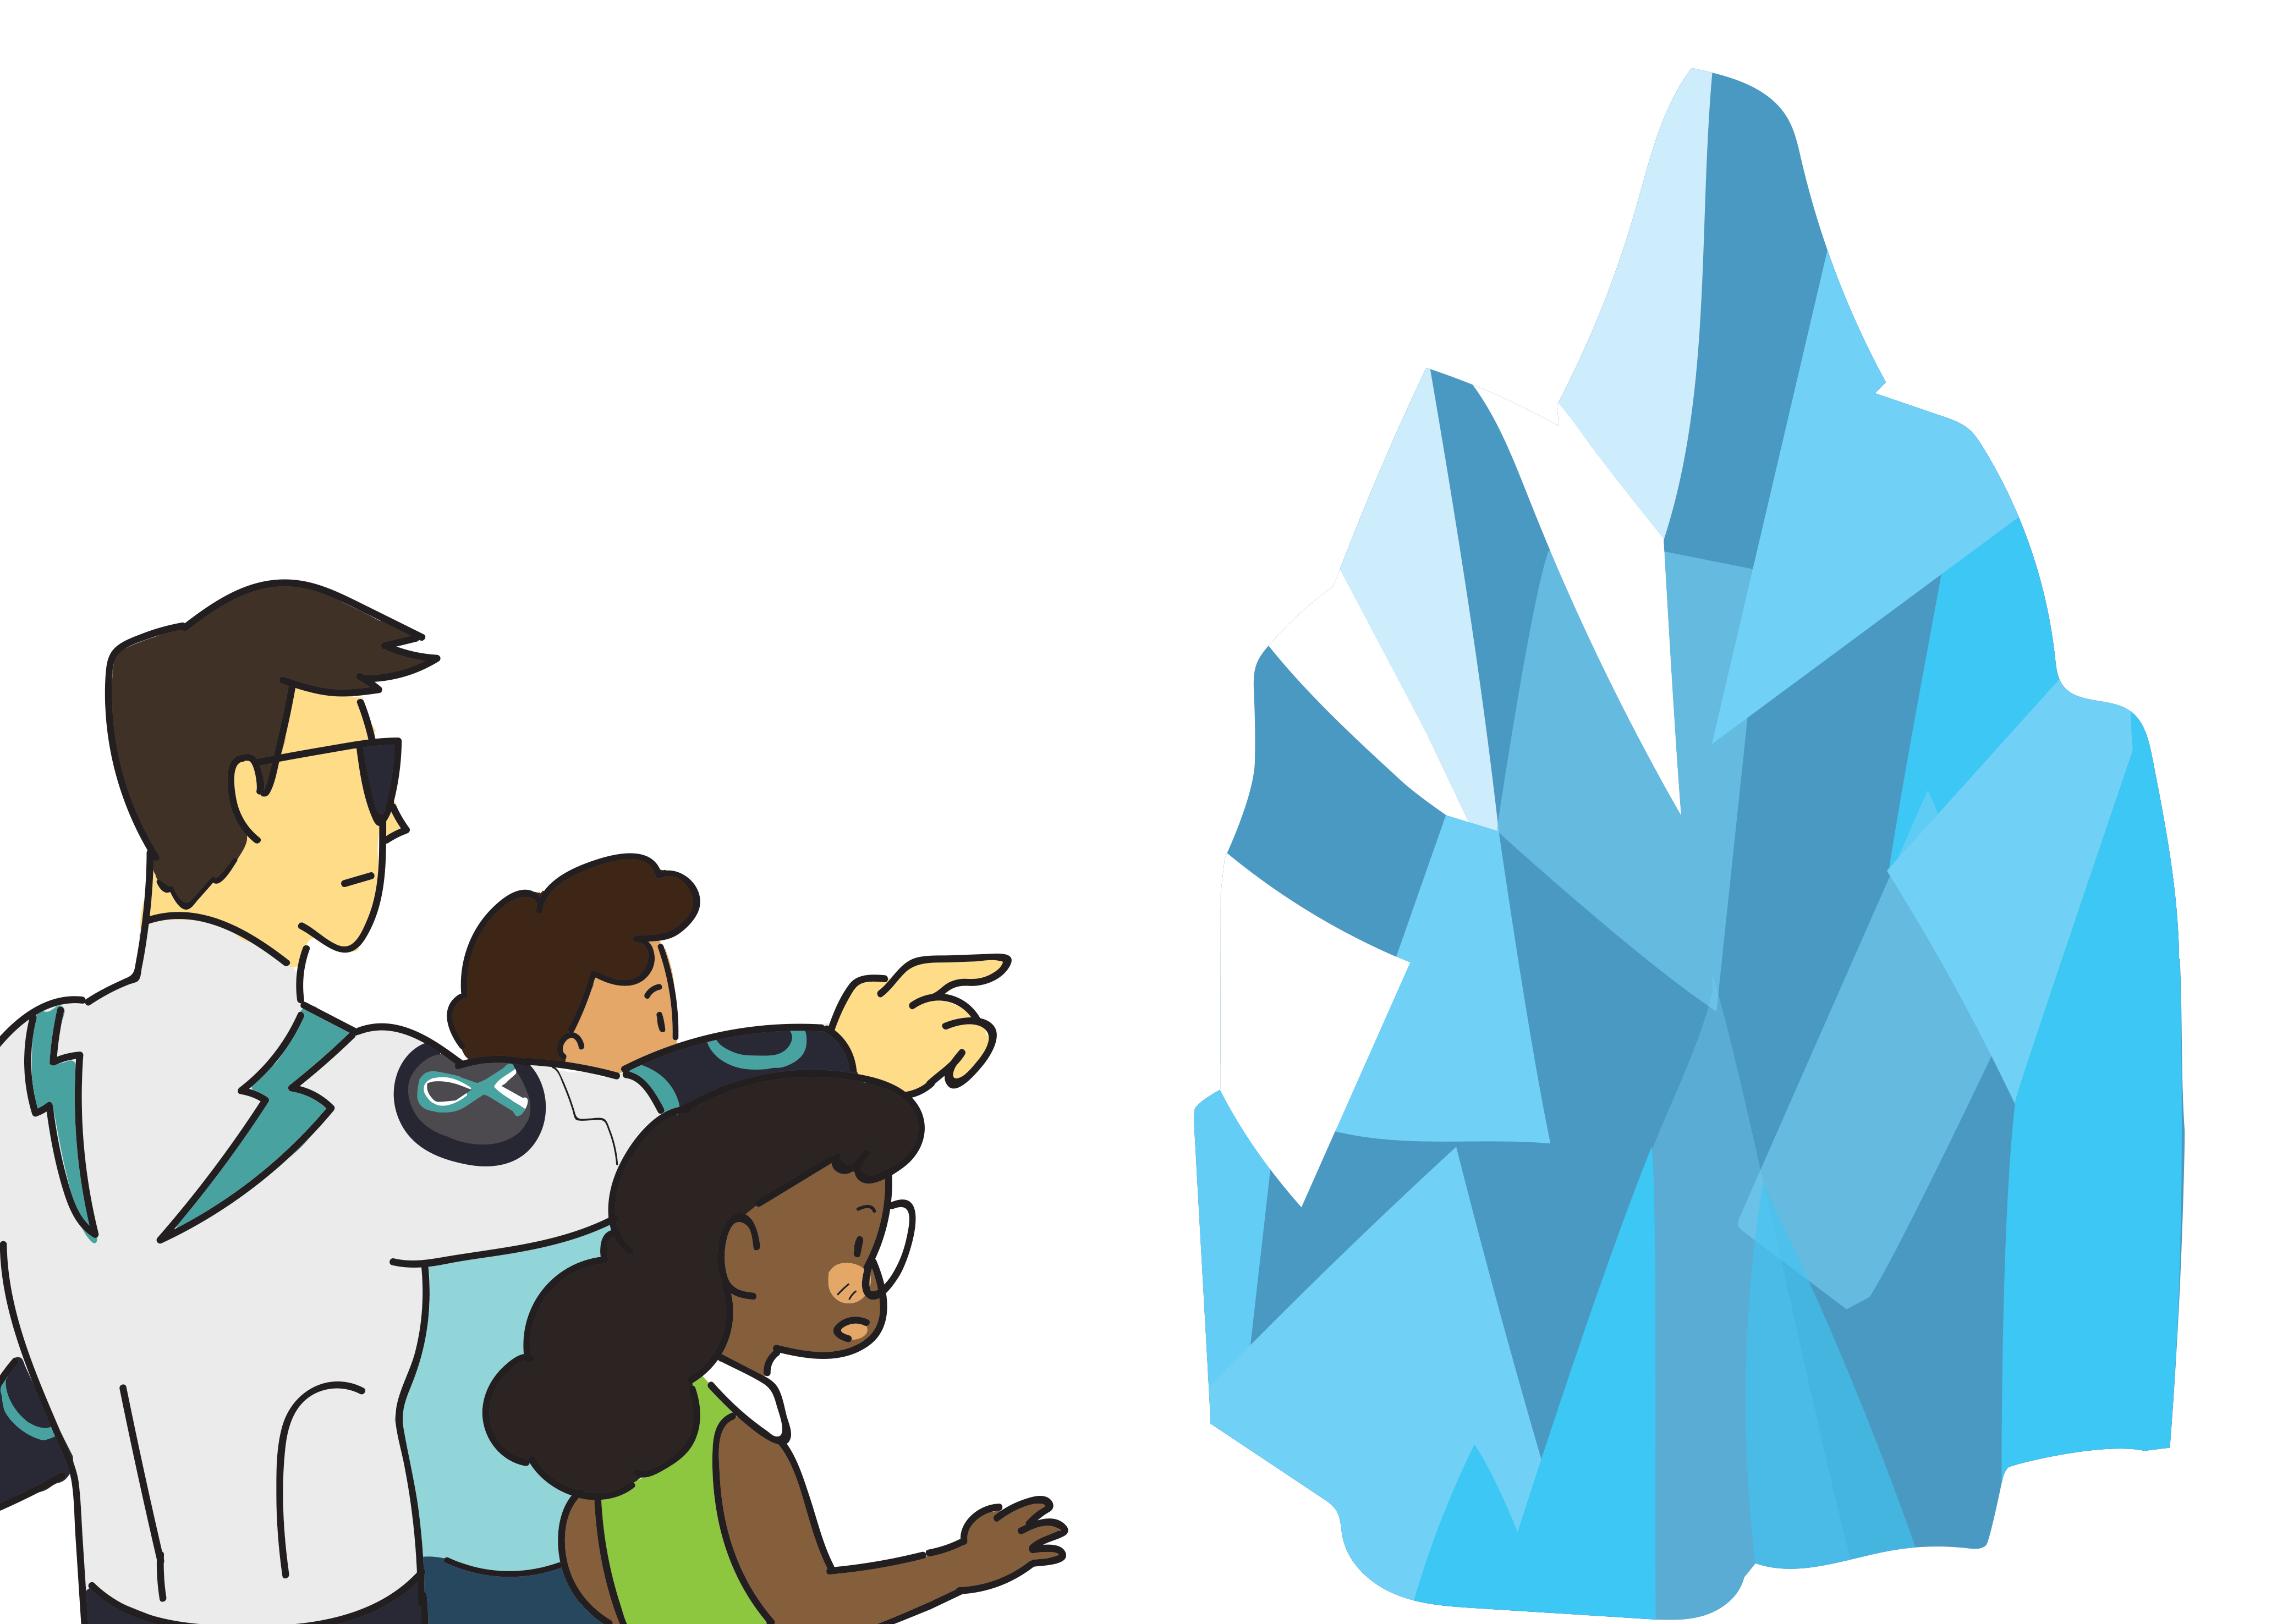


Melt the ICE
Refusal Tips
Be Firm. RefuSe the drug offer.
Be Brave. Walk away.
Be POsitive. Spend your time on healthy activities.
Be Firm. IgnoRe the suggestion to try drugs.
Be Positive. Make a pact with your friends to stay Drug-free
Captain Drug Buster informs Hassan and Ashley that the third tool is trapped within a gigantic ice sculpture at the void deck.
Help them unveil the third hidden tool by completing the crossword puzzle with refusal tips when offered drugs.
(d)
(a)
 |  |  |  |  |  |  |  |  |  | N
R |  | F |  | S
 |  |  | (b) |  | A | L | K |  |  | R
(c) |  |  | P |  |  | I |  | I | V | E
 |  |  |  | R
 |  |  | (e) | D |  |  | G | - | F |  |  | E
I
G
E
U
E
O
W
O
S
T
R
U
R
E
The third hidden tool located here is a
Sword
17
18

Slide 9
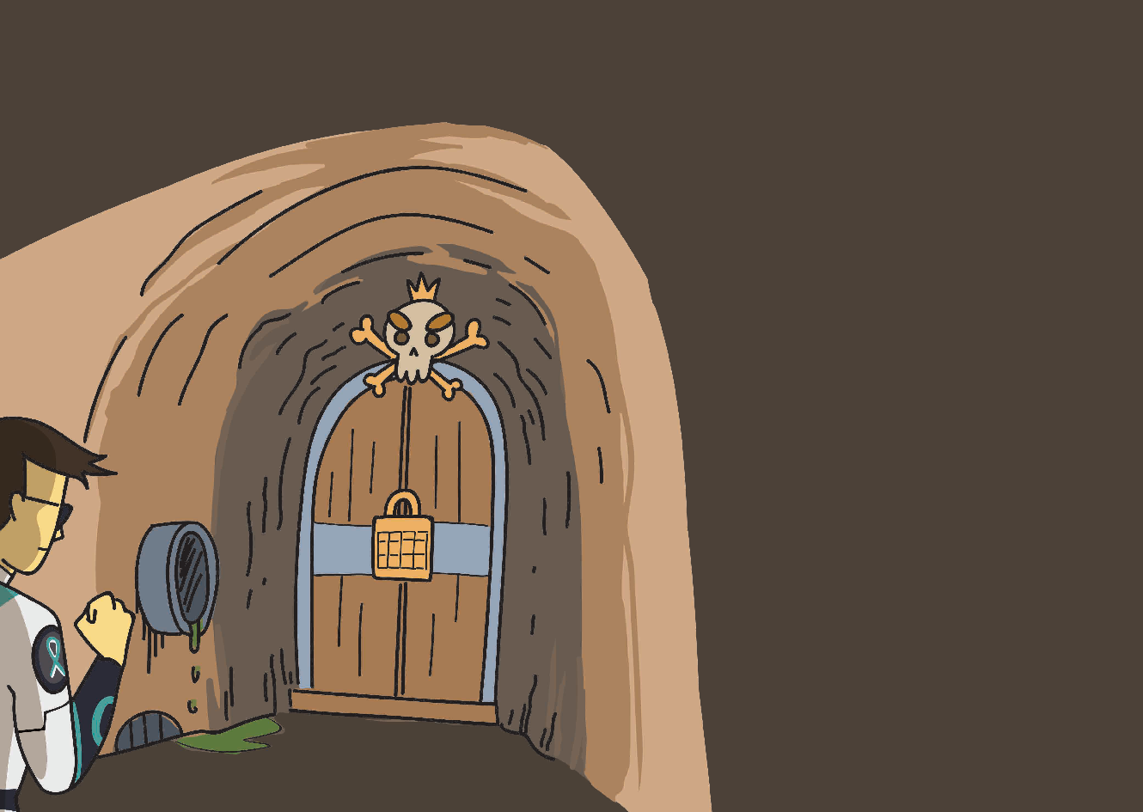
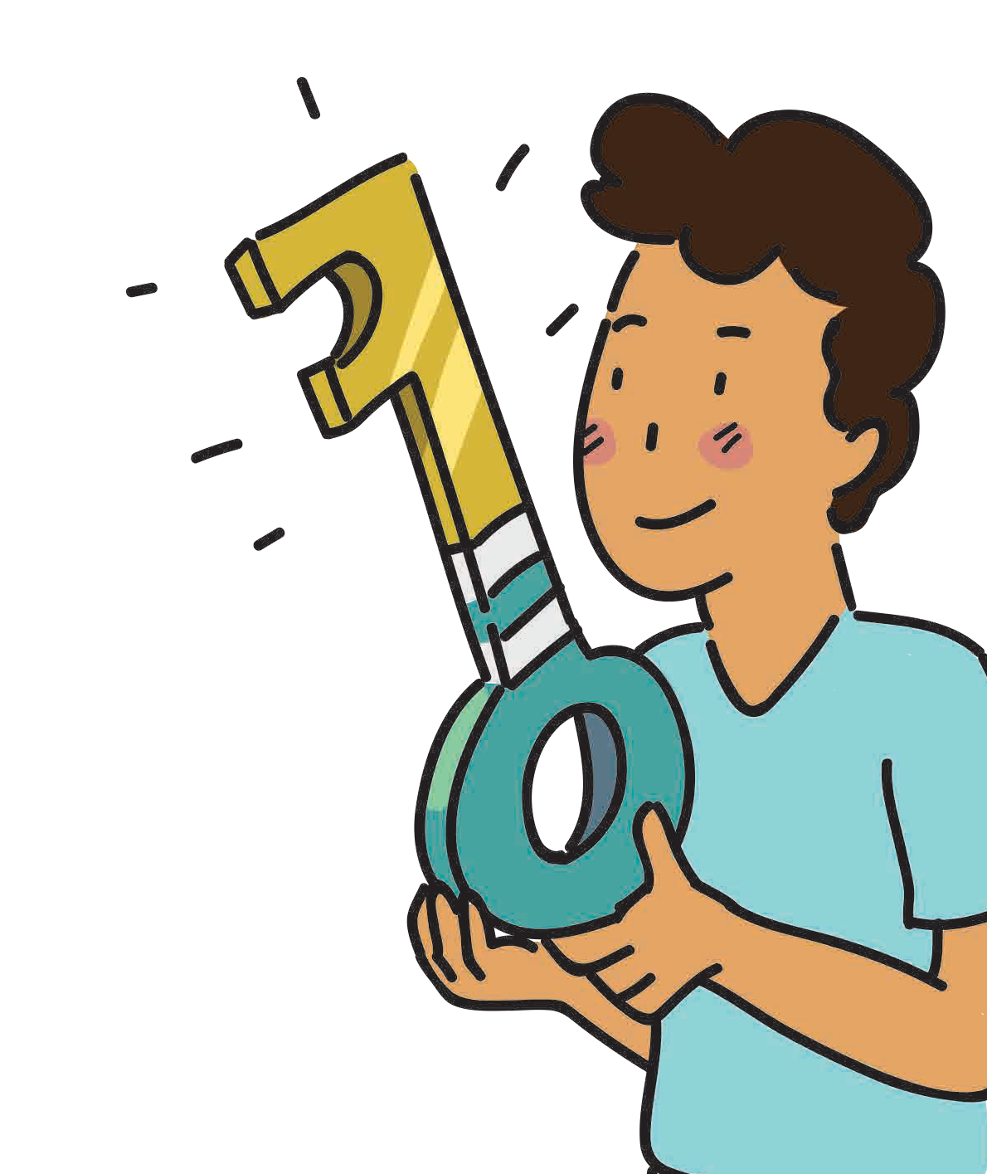
Crack the Code
1 Brave |  | 2 |  | 3 Healthy
4 Curious |  | 5 Firm |  | 6 Ignorant
7 Escapism |  | 8 Confusion |  | 9 Positive
Captain Drug Buster, Hassan and Ashley made it to the entrance of Drug Lord’s Lair but they cannot enter!
To unlock the door, Hassan and Ashley need to crack the secret code. They need to identify the right qualities and values for people to stay drug-free.
Peer Pressure
Write down the correct code (in ascending order) in the boxes below. Use the code and the key to unlock the door!
1 3 5 9
19
20

Slide 10
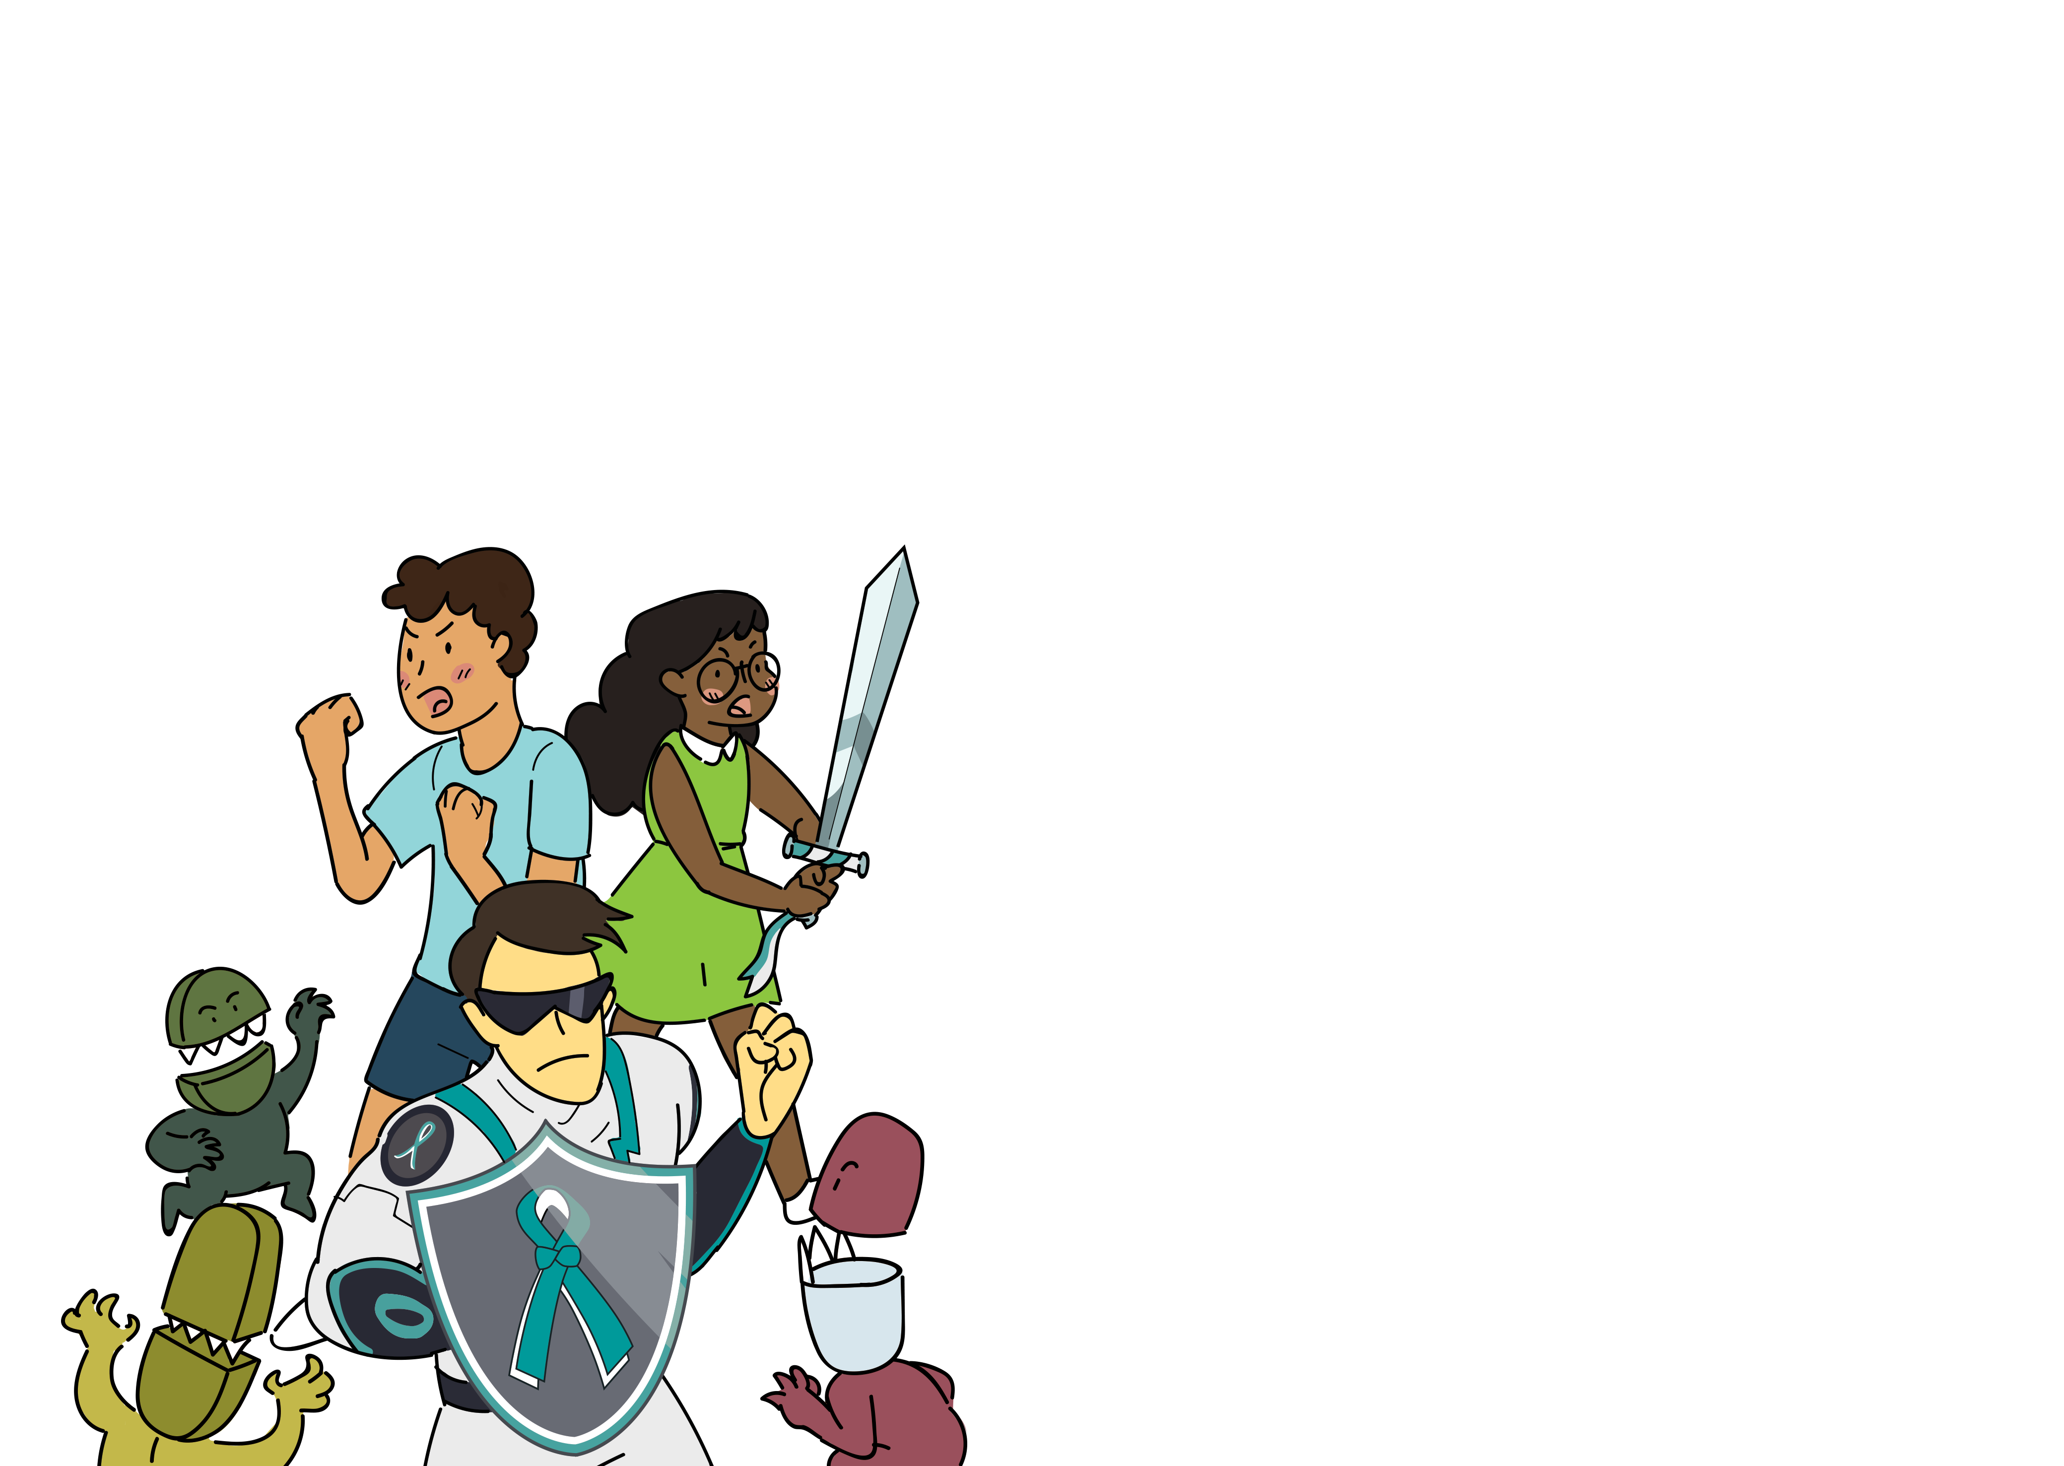
Make good choices in life
 | Good Choices | Good Outcomes
Hassan | I choose to spend my time on healthy activities such as sports. | I grow up healthy and strong.
Ashley | I choose to spend quality time with my family and friends. | Life is short. I do not waste precious time under the influence of drugs.
Captain Drug Buster | Choose your friends wisely and hang out with good company. | It is comforting to know that your friends will support your choice to stay drug-free. Sometimes, “WE” is stronger than “I”.
Me
The Drug Minions are everywhere in the Lair! Captain Drug Buster, Hassan and Ashley need to use the sword and shield to fight them off.
Help them defeat the Drug Minions by writing down the healthy lifestyle alternatives that will keep you away from trying drugs!
21
22

Slide 11
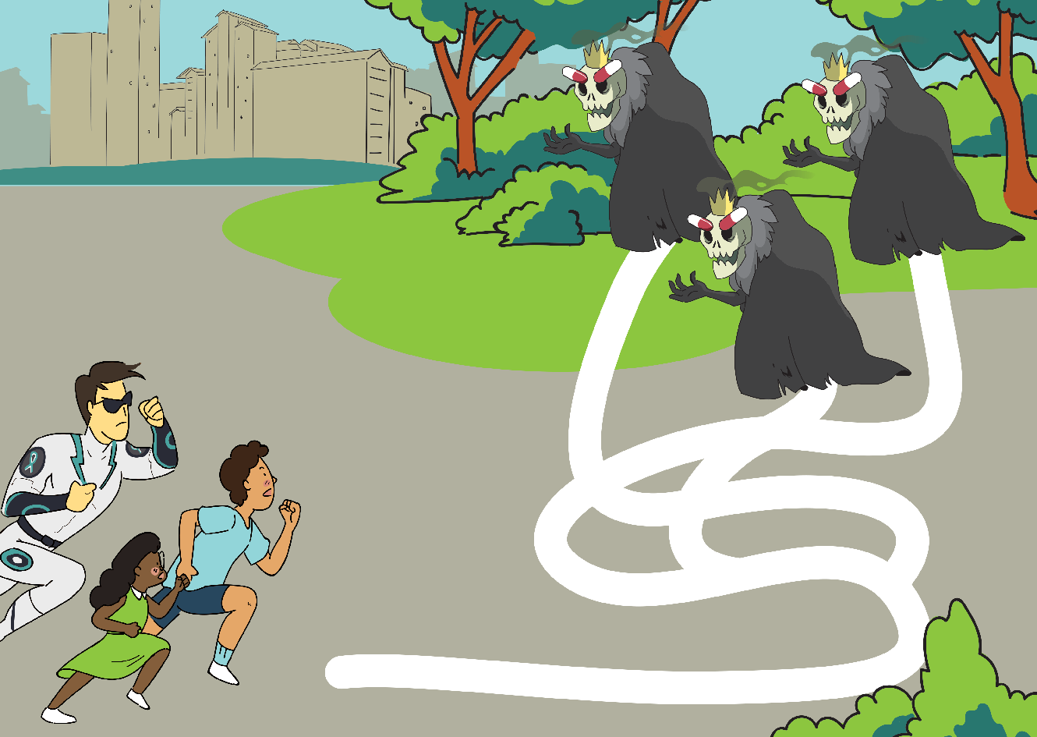
Lead the way to
a drug-free life!
At last, Captain Drug Buster, Hassan and Ashley found Drug Lord! However, he has divided himself into 3 identical forms to confuse them.
Help Captain Drug Buster, Hassan and Ashley identify the real Drug Lord by connecting the tell-tale signs of drug abuse.
Trace the path to the real Drug Lord and banish him with the sword!
Doing well in your Maths test
a
i
n
Dining with family
m
o
s
n
I
Quarrelling with family
Joining a band
g
and
n
i
learning
i
s
c
r
guitar
e
x
E
Anxiety and nausea
nose
Difficulty in concentration
runny
Watery eyes
and
23
24

Slide 12
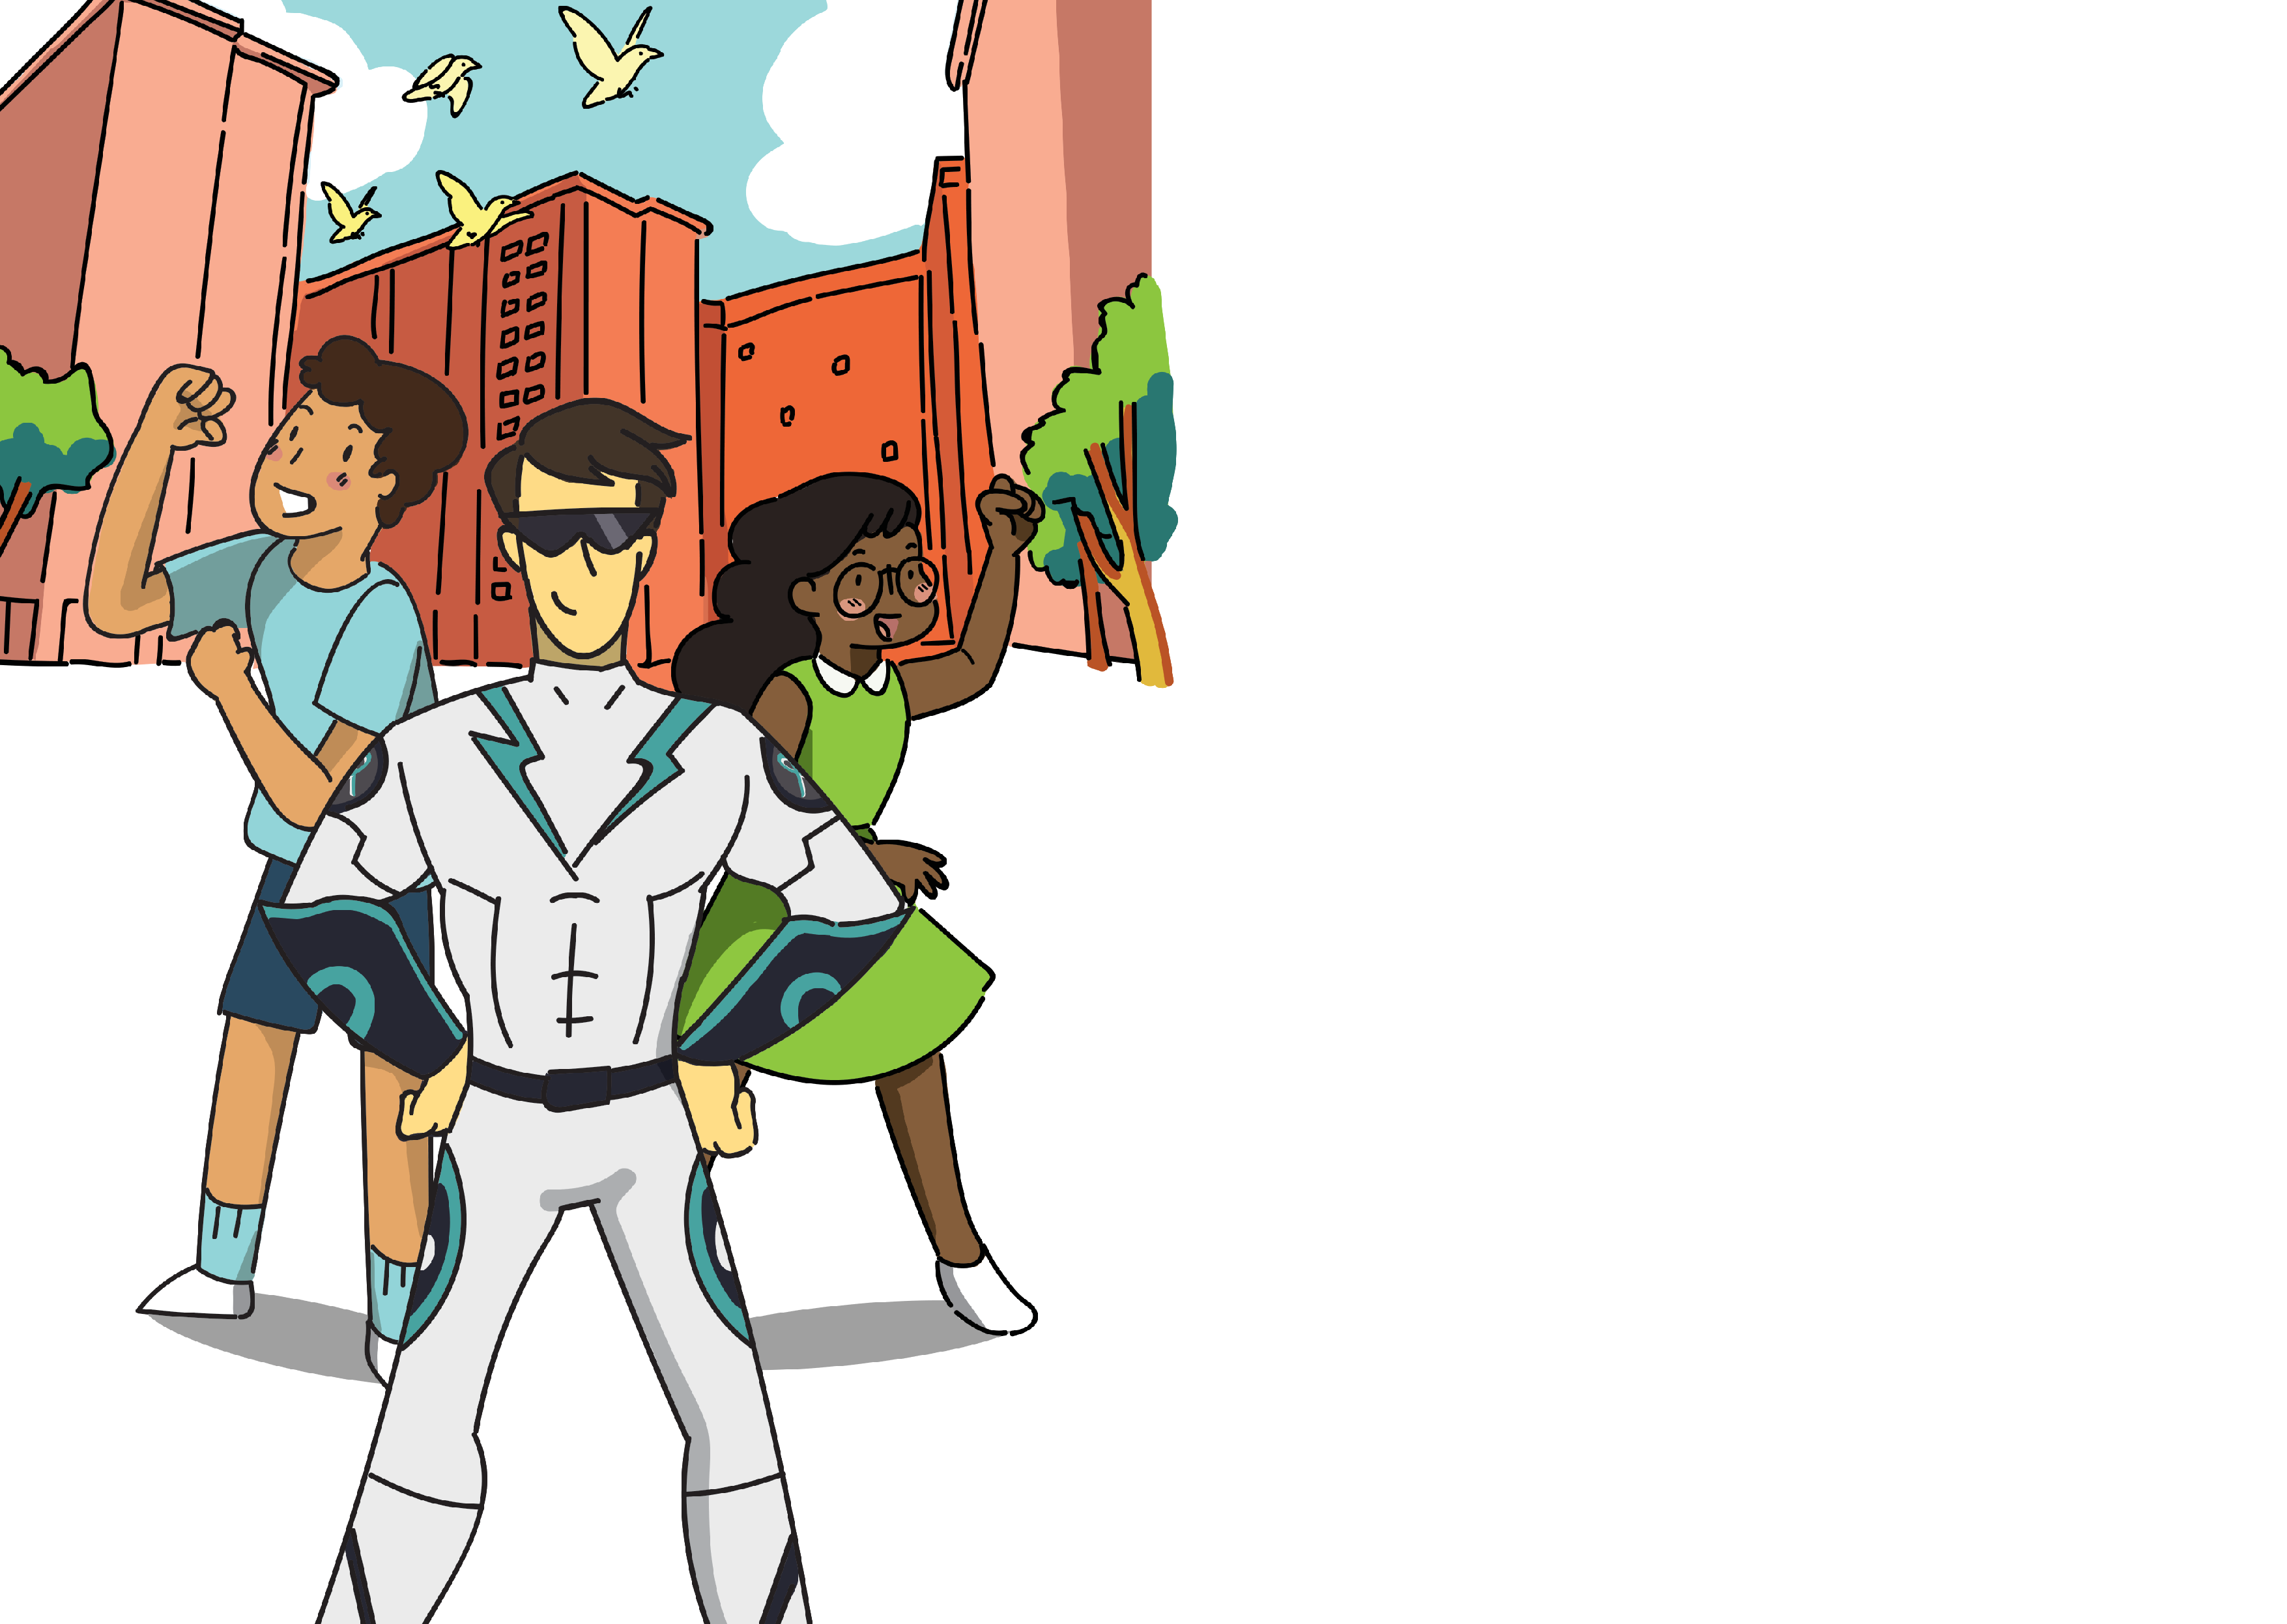

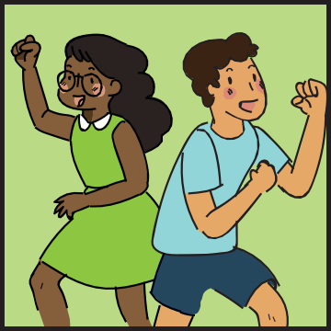
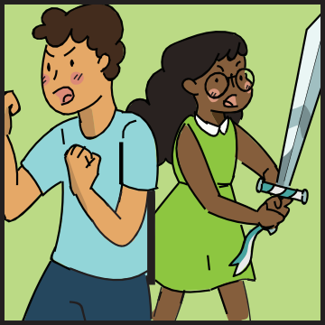
Let’s Reflect
Yay! They did it! The neighbourhood is finally safe from Drug Lord.
Throughout this quest, Captain Drug Buster has noticed how Hassan and Ashley have applied the 3 Golden Values.
Be Brave!
Be brave to turn away from drugs and to approach the adults when you encounter trouble.
Be Firm!
Never give in to temptation or peer pressure. Always say NO to drugs.
Be Positive!
Think positively as this will help you to make the right choices in life.
Identify which Golden Value is demonstrated in each of the 3 pictures below. Ask your teacher or parents for help if you need!
Golden Value is:
Golden Value is:
Golden Value is:
Be Firm
Be P ositive
Be B rave
25
26

Slide 13

Pledge to stay drug-free
Recognising your contributions to the success of the mission, Captain Drug Buster has invited you to join his ranks.
Write down your pledge to stay drug-free and become a Corporal Drug Buster!
Remember Captain Drug Buster’s Golden Values:
Be Firm! Be Brave! Be Positive!
I pledge to stay drug-free by:
Name
Date
27
28

Slide 14
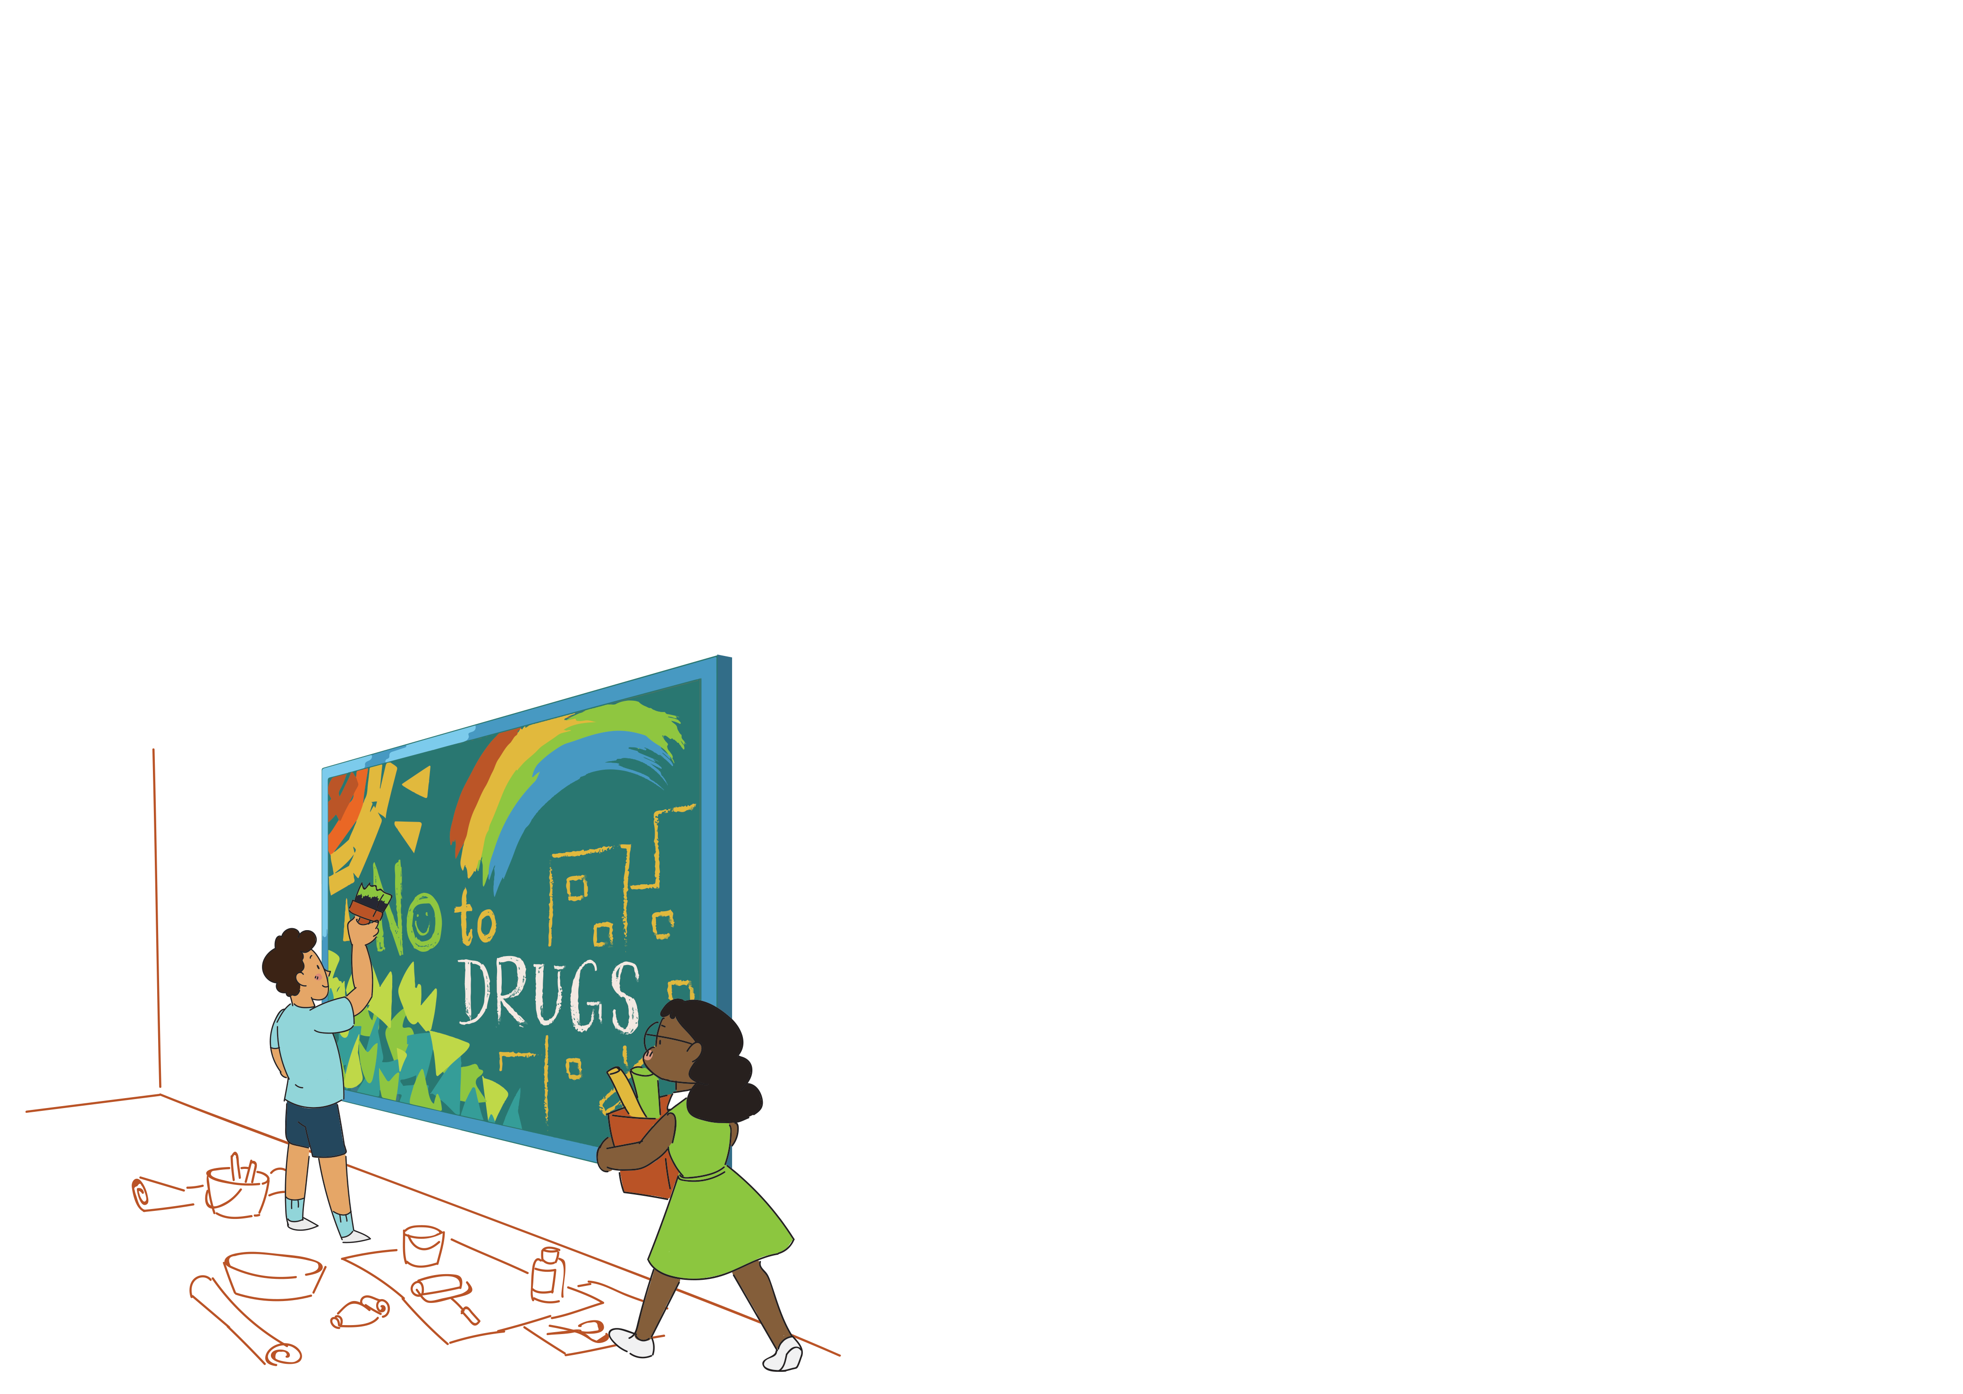
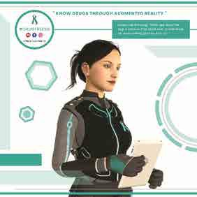

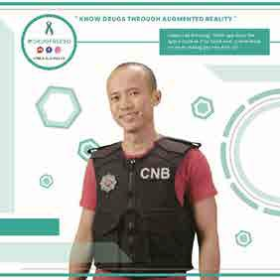

Anti-Drug Montage
Step into the world of
Augmented Reality!
We commemorate the International Day Against Drug Abuse and Illicit Trafficking, also known as World Drug Day, on 26 June every year. In conjunction with the Anti-Drug Abuse Campaign (ADAC), we hold an annual competition for primary school students to create anti-drug montages within their school premises.
A cash prize of $500 each will be given to 10 schools with the best anti-drug montages.
Details on submission can be found in the Instructions Guide sent to the teacher-in-charge.
Download the DrugFreeSG app from IOS App Store or Andriod Play Store on your mobile devices and embark on an exciting anti-drug journey as you interact with the virtual characters!
Scan the AR markers below to hear their stories!
Cara, Anti-Drug Advocate
Aaron, Drug Abuser
Luke, CNB Officer
Aaron’s Aunt
29
30

